Slide 1
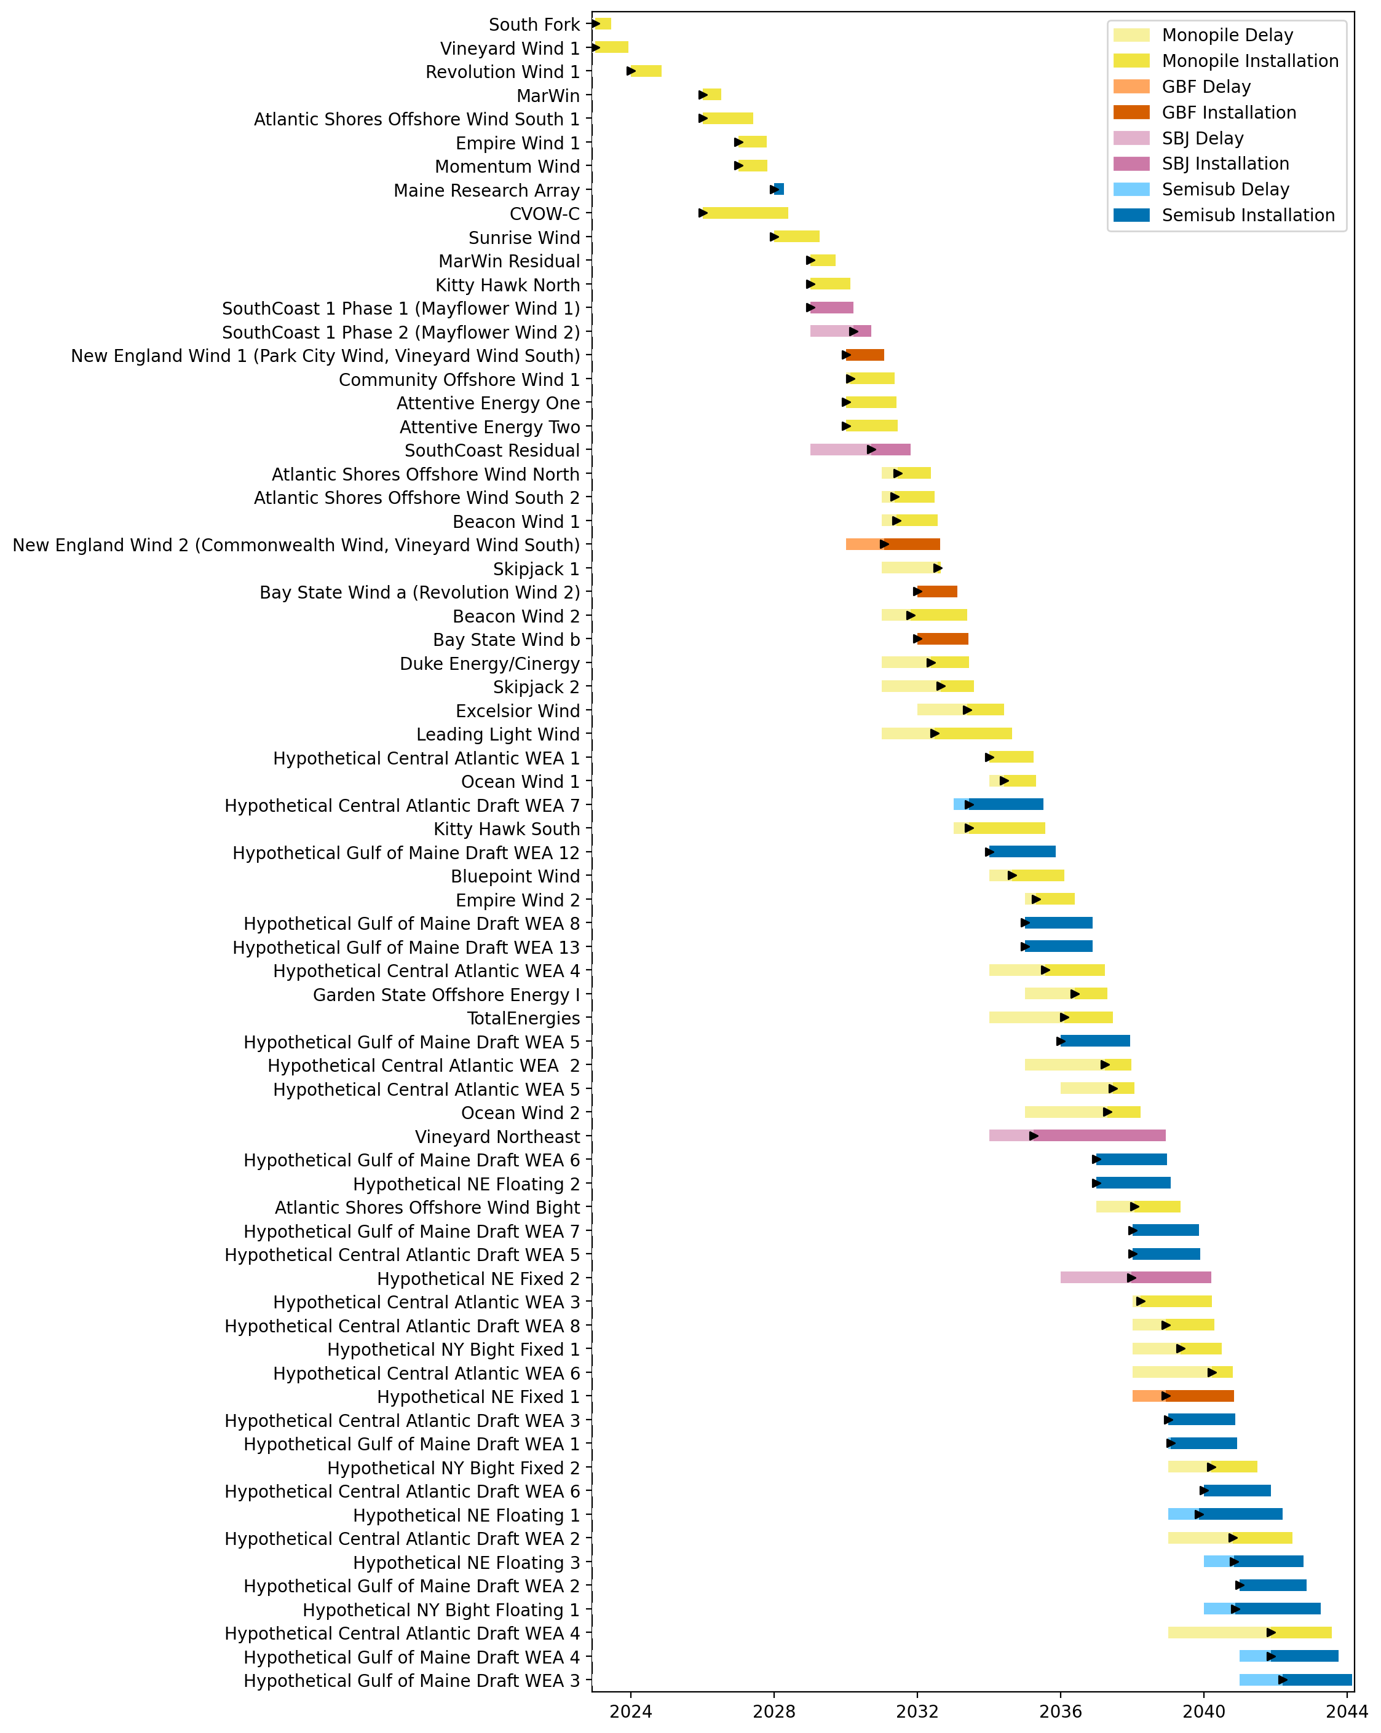
Full Gantt

Slide 2
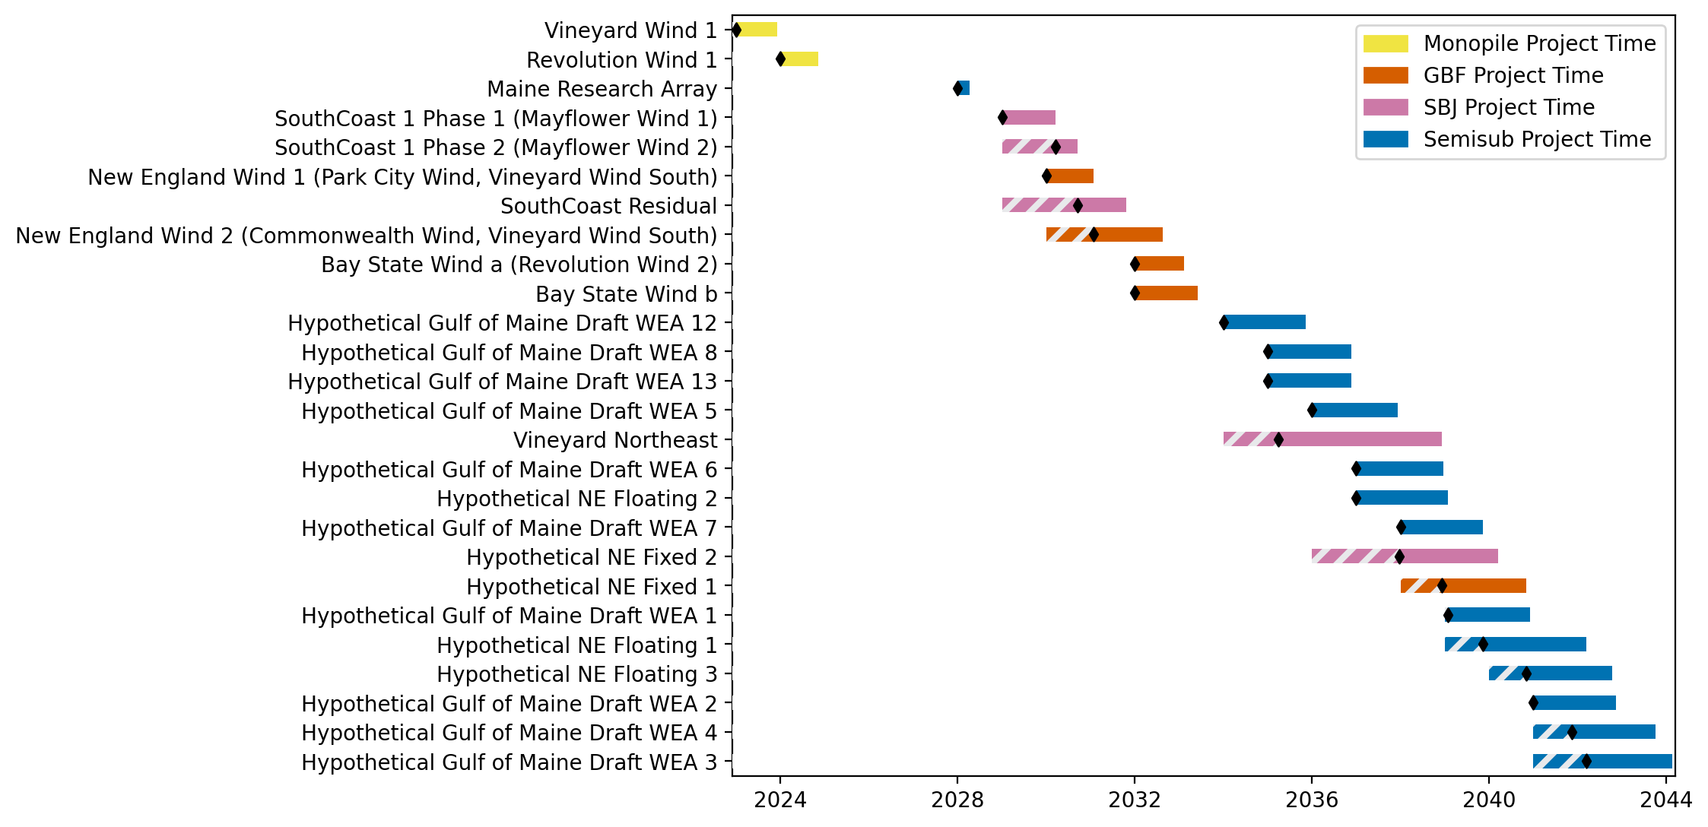
New England Gantt

Slide 3
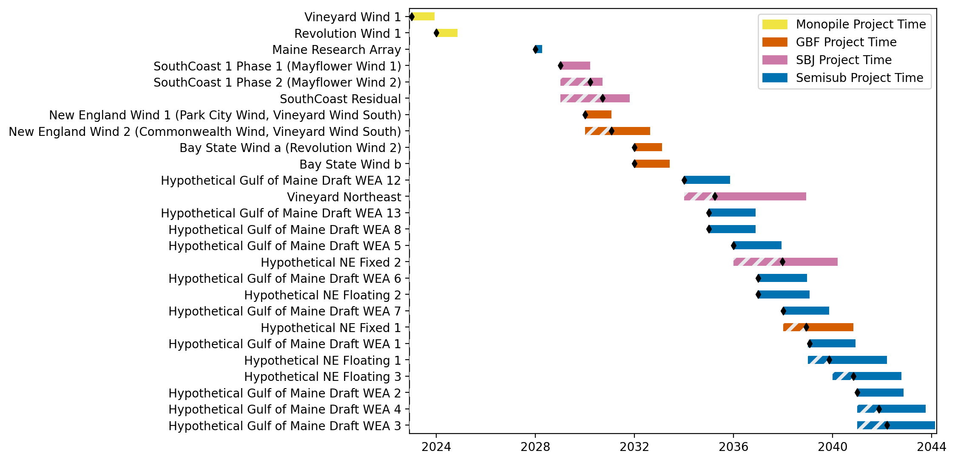
Sorted New England Gantt

Slide 4
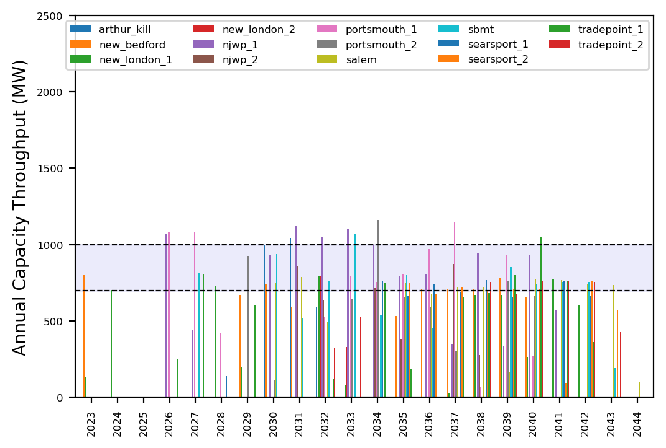
Port Throughput

Slide 5
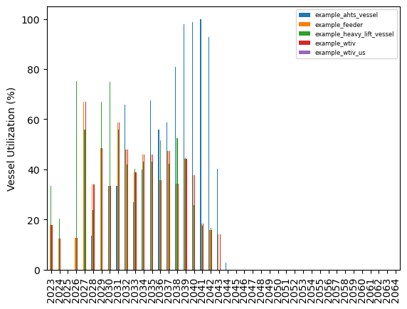
Vessel Utilization

Slide 6
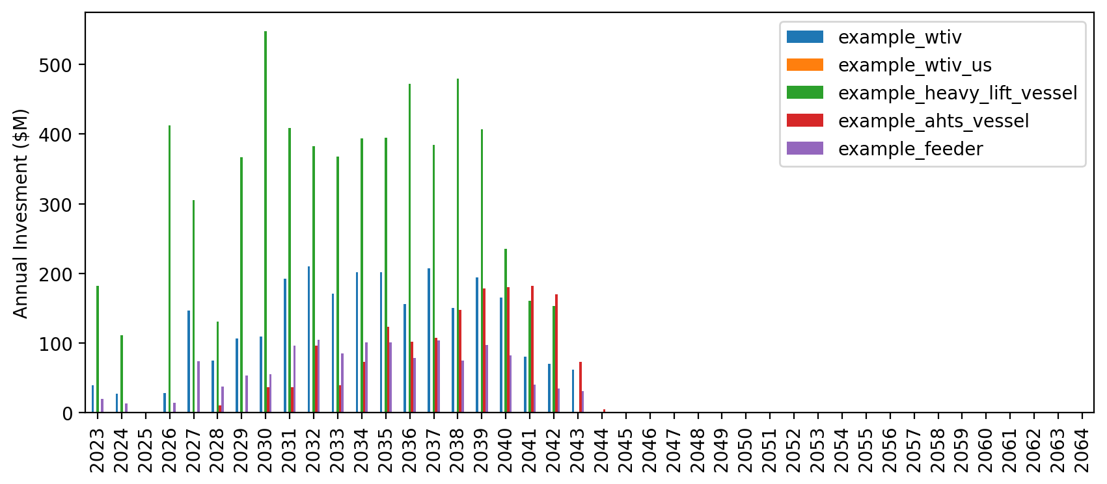
Vessel Revenue

Slide 7
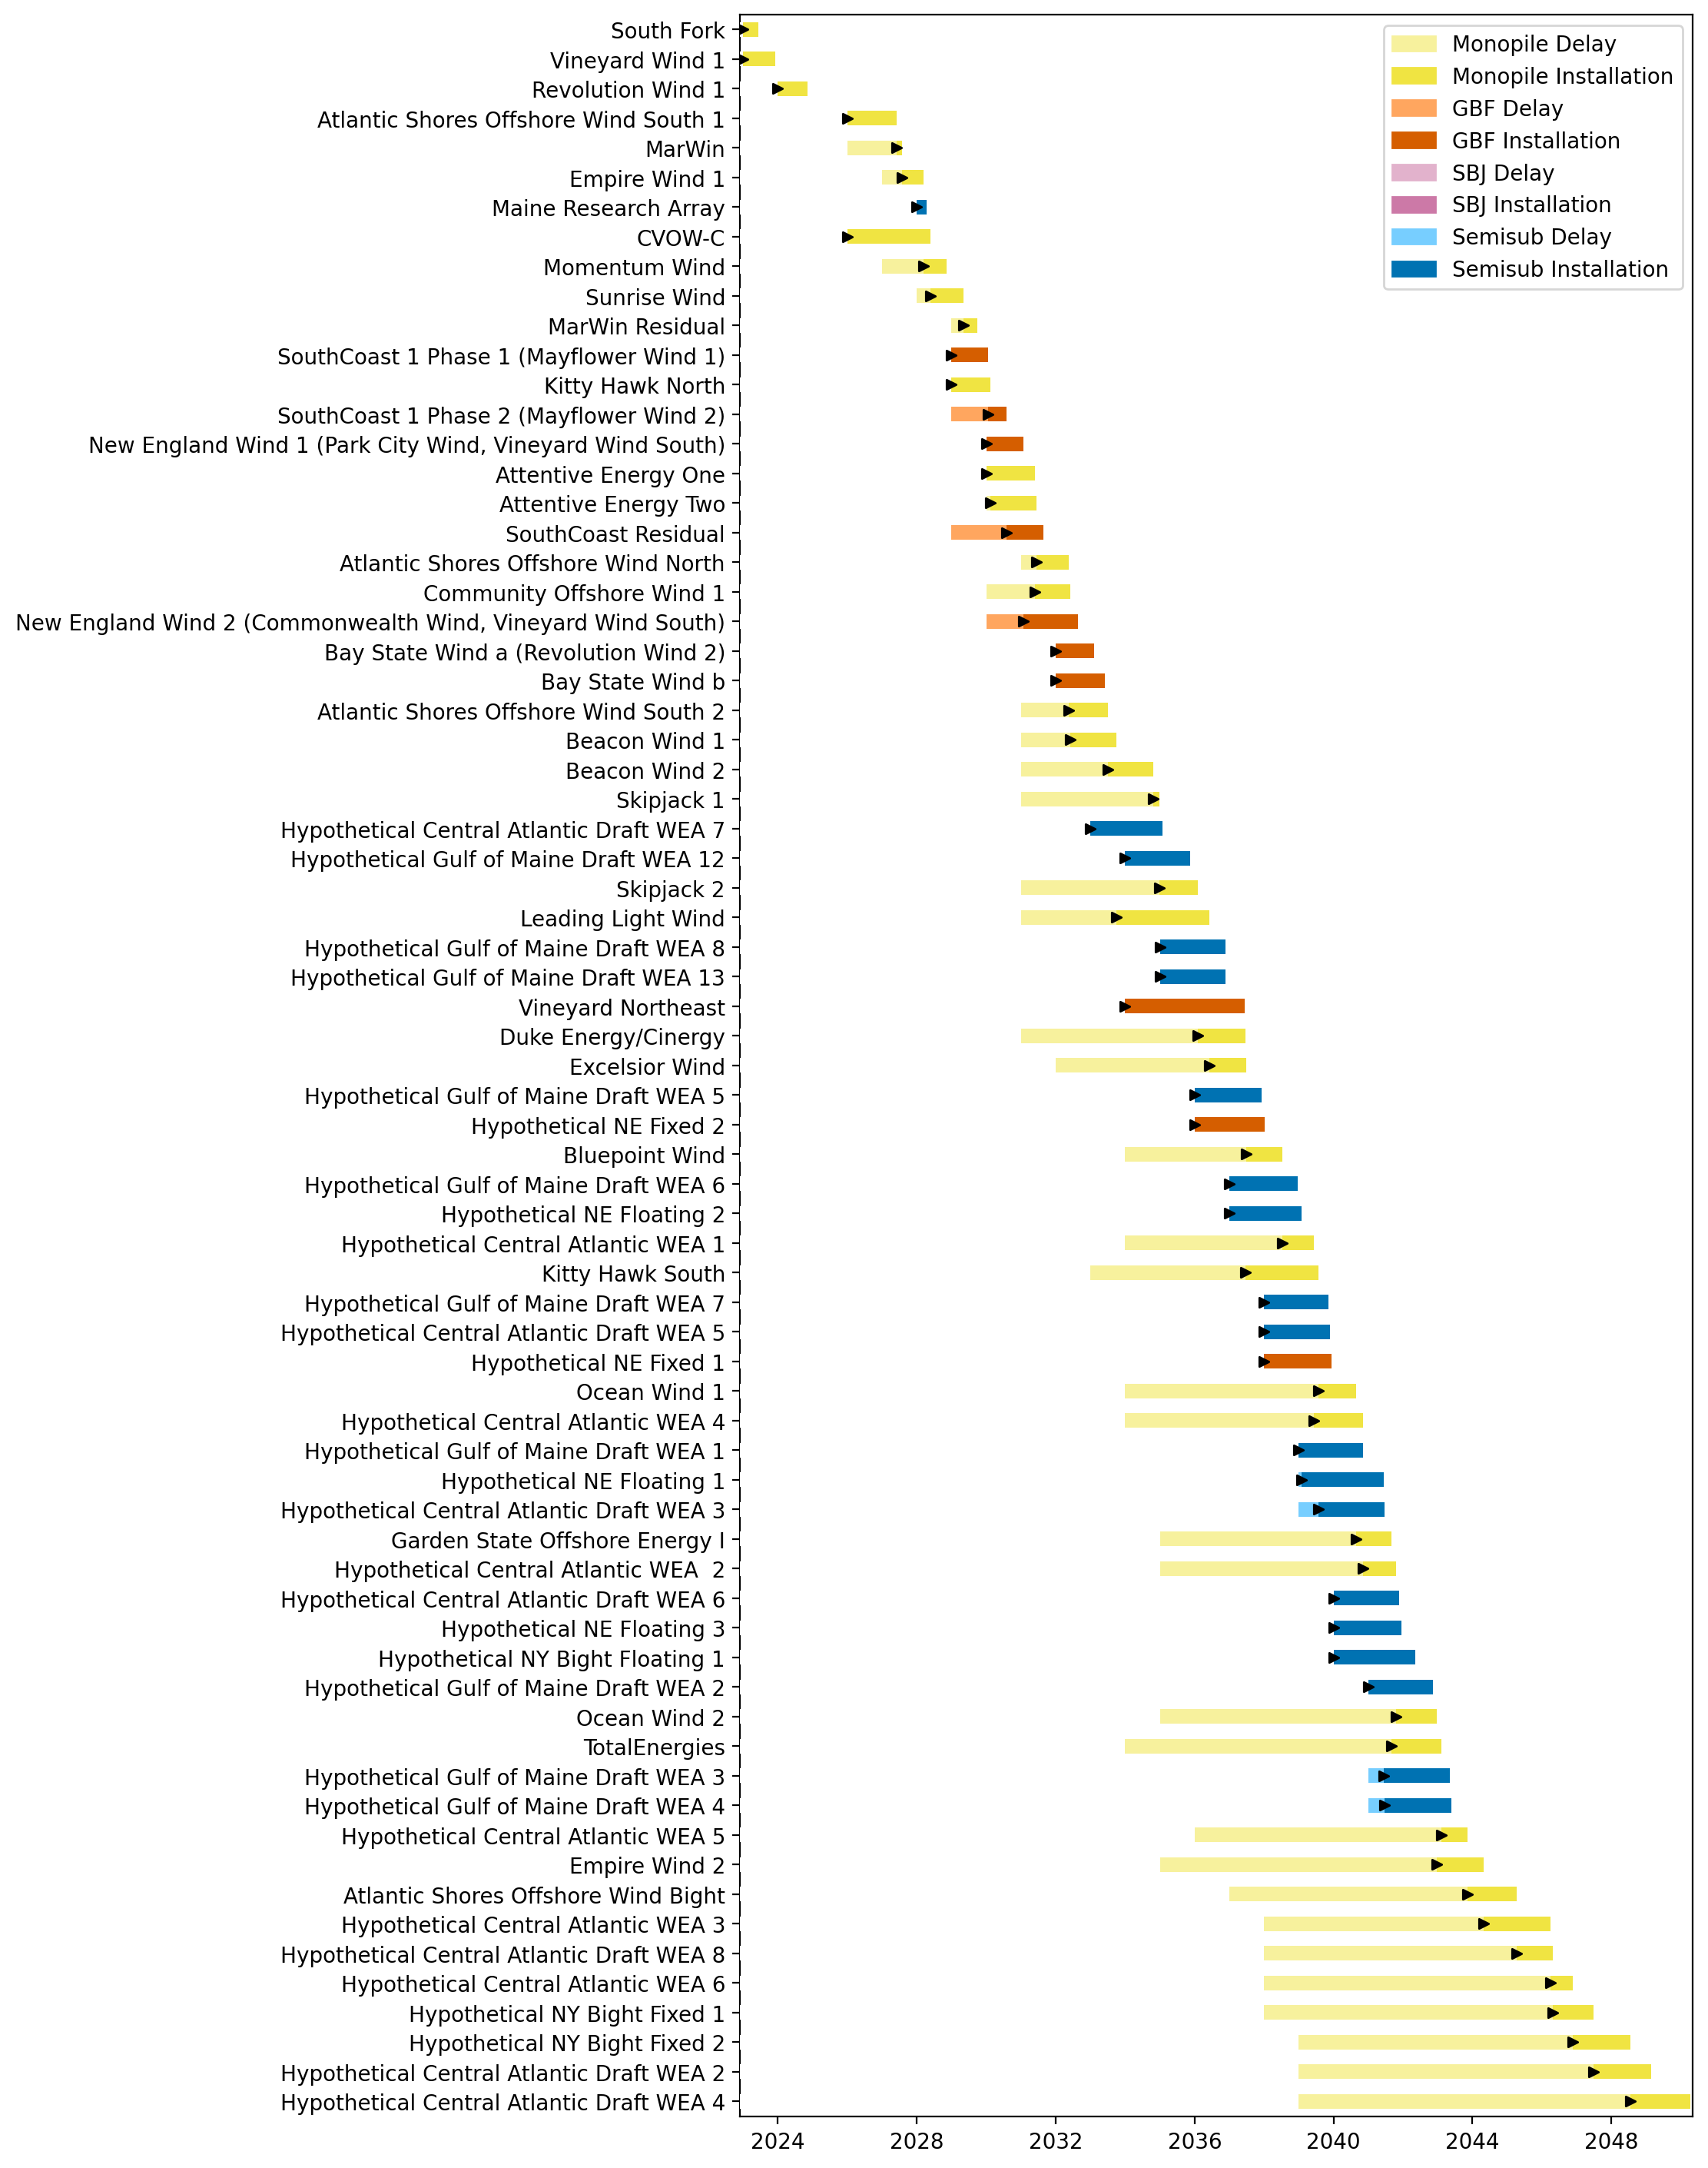
Full Gantt

Slide 8
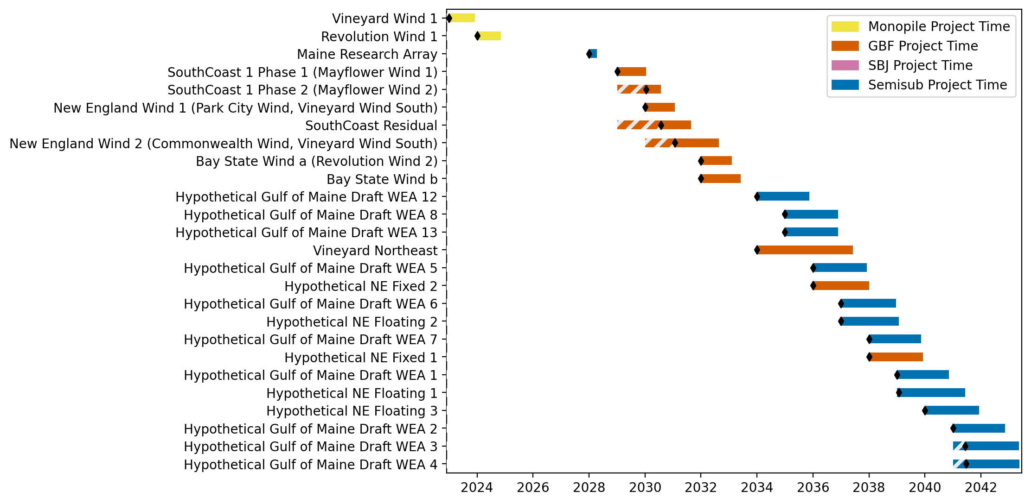
New England Gantt

Slide 9
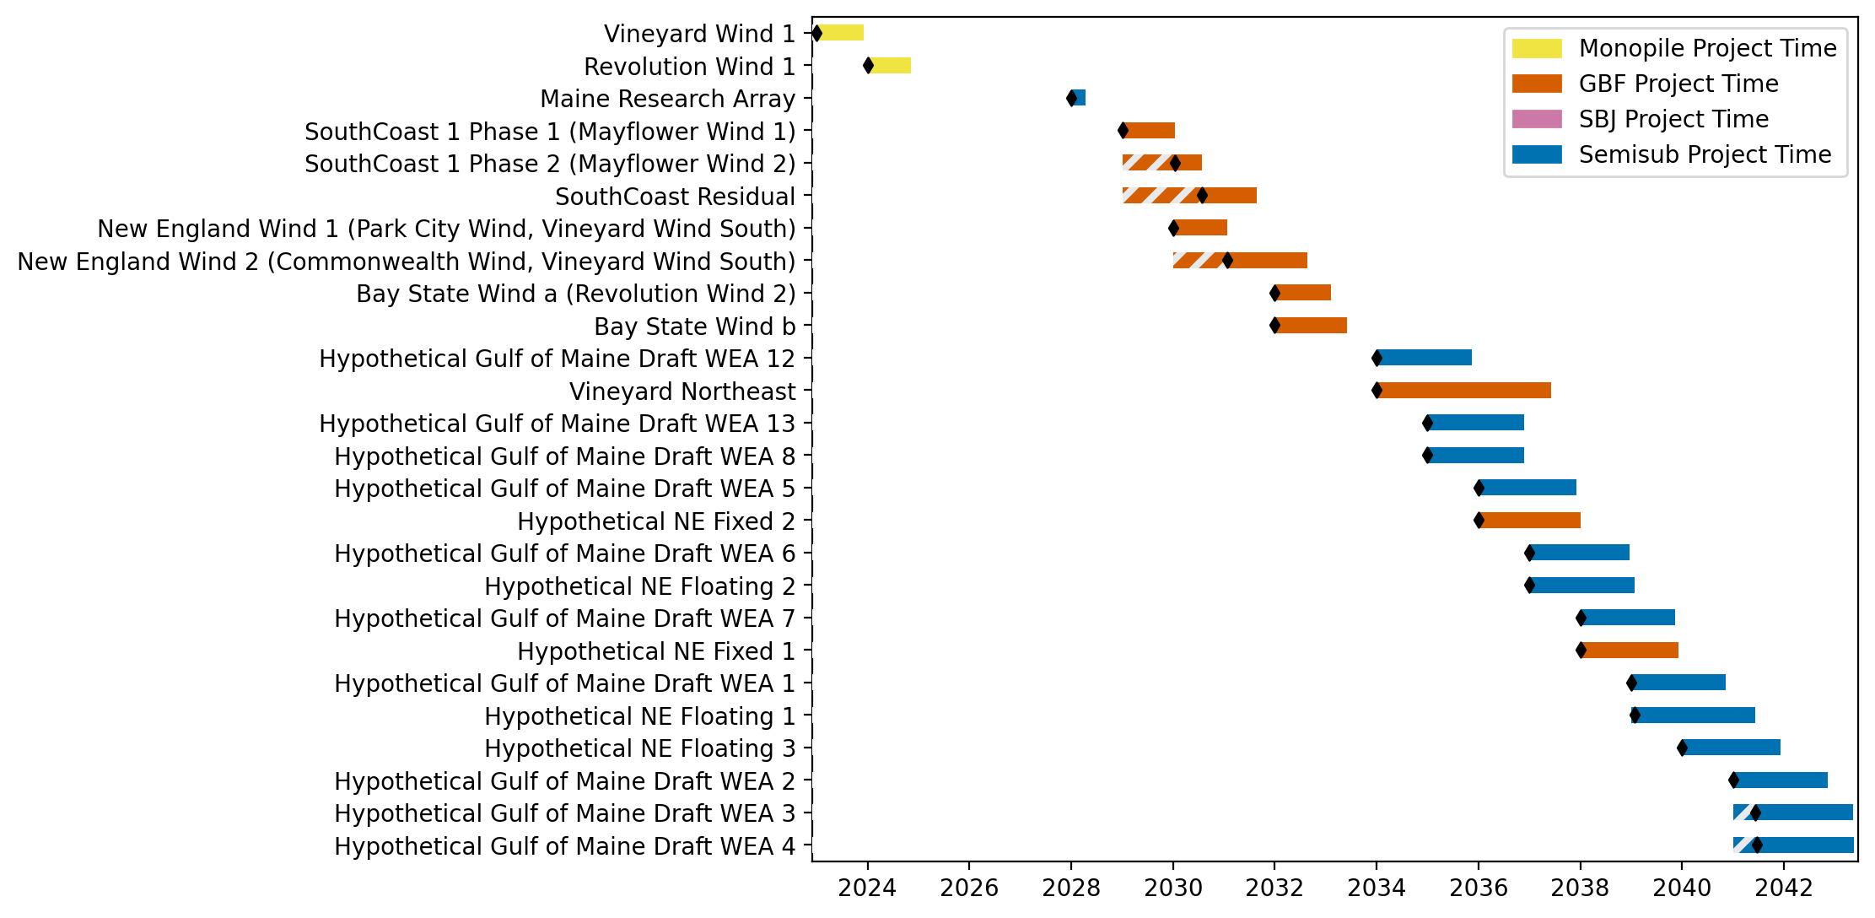
Sorted New England Gantt

Slide 10
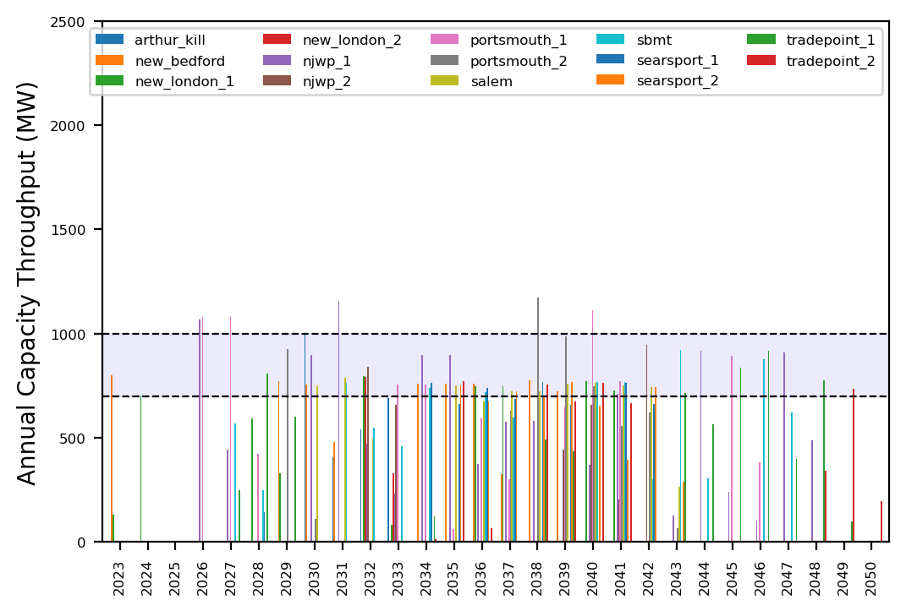
Port Throughput

Slide 11
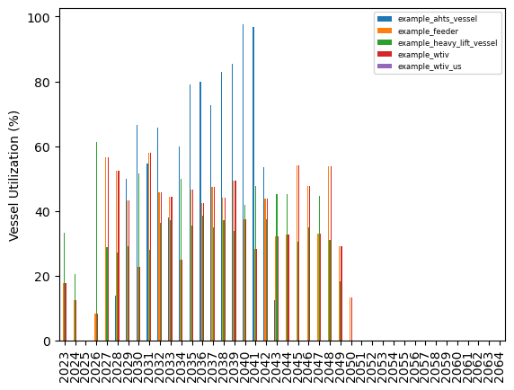
Vessel Utilization

Slide 12
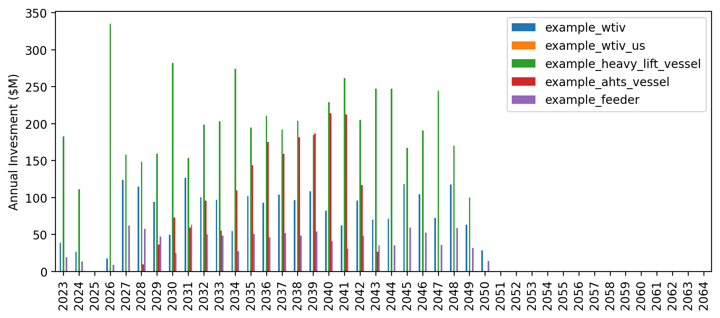
Vessel Revenue

Slide 13
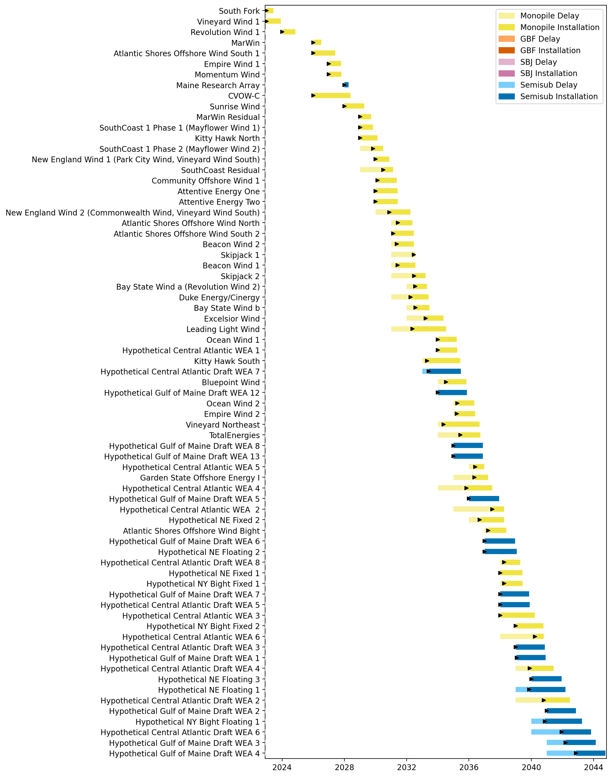
Full Gantt

Slide 14
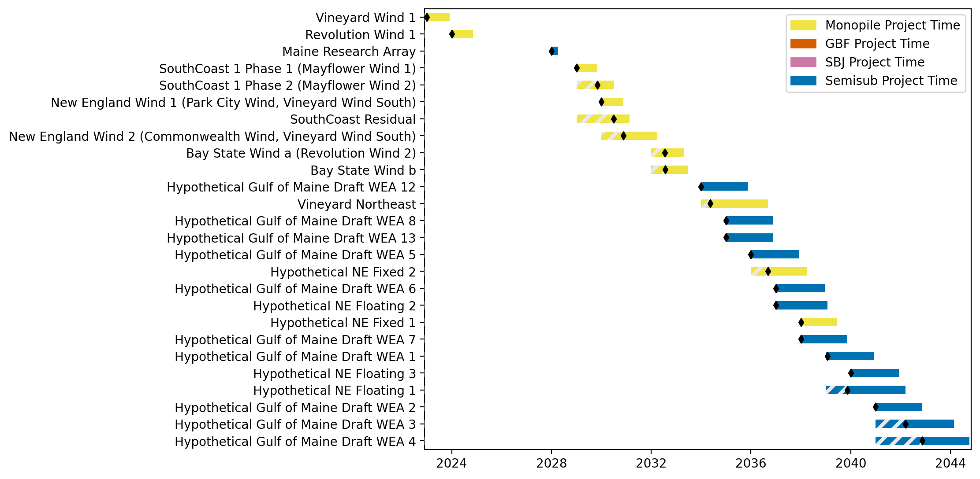
New England Gantt

Slide 15
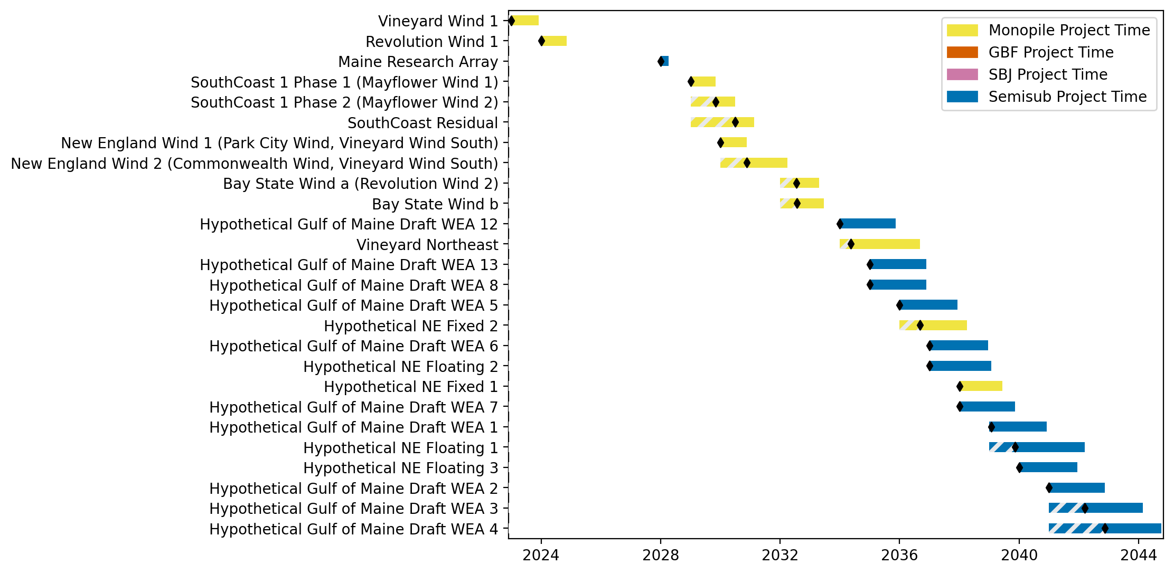
Sorted New England Gantt

Slide 16
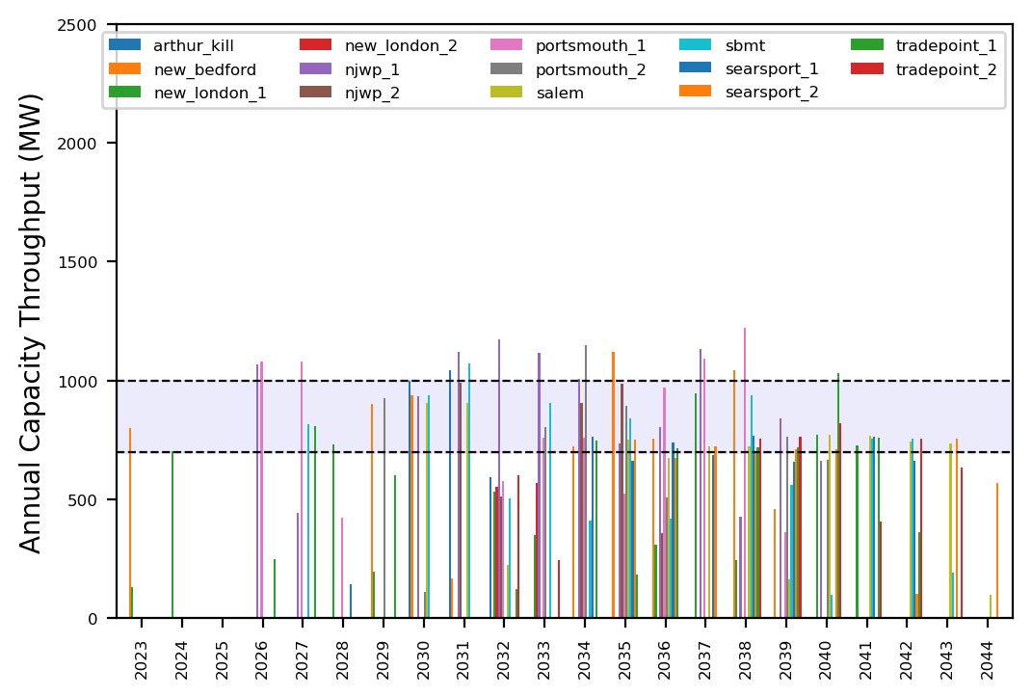
Port Throughput

Slide 17
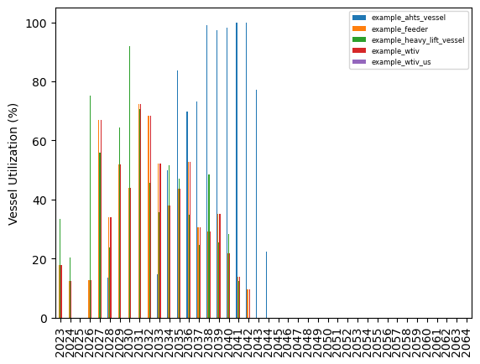
Vessel Utilization

Slide 18
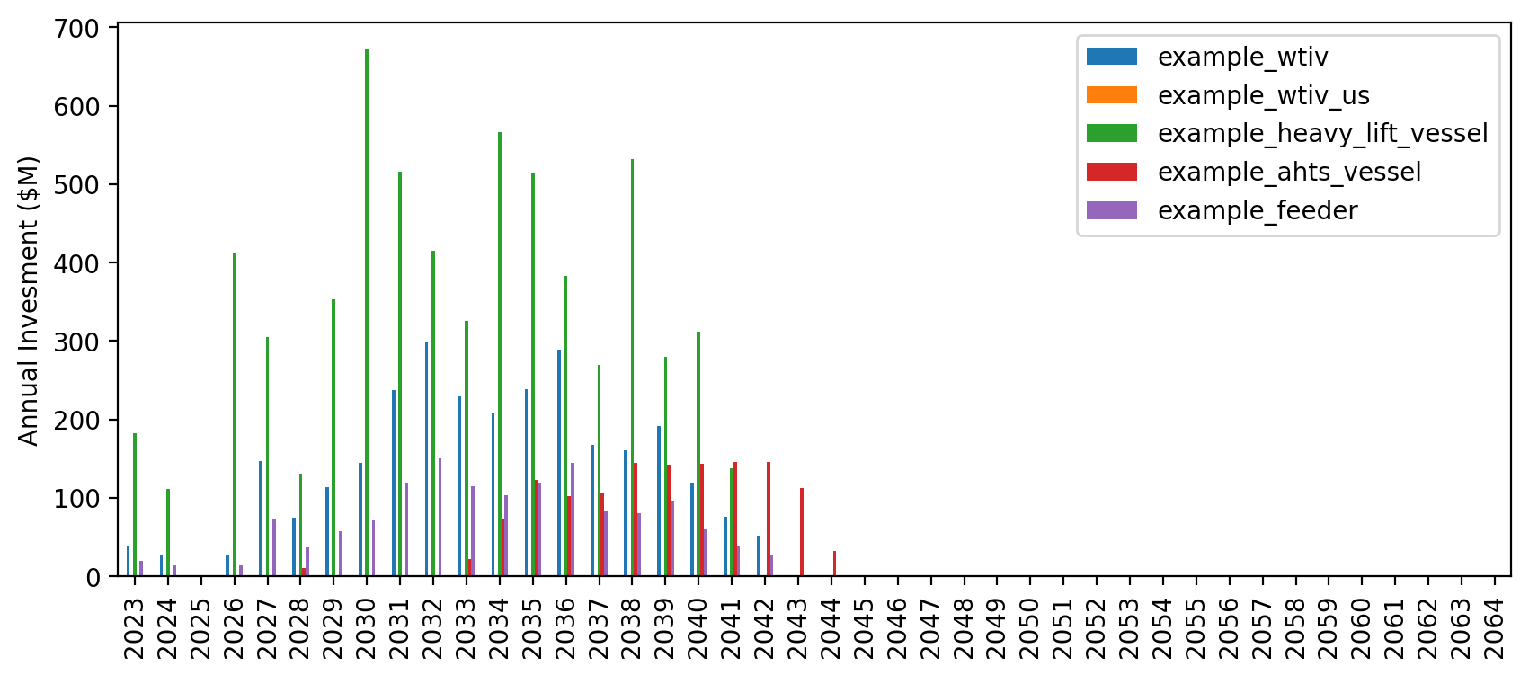
Vessel Revenue

Slide 19
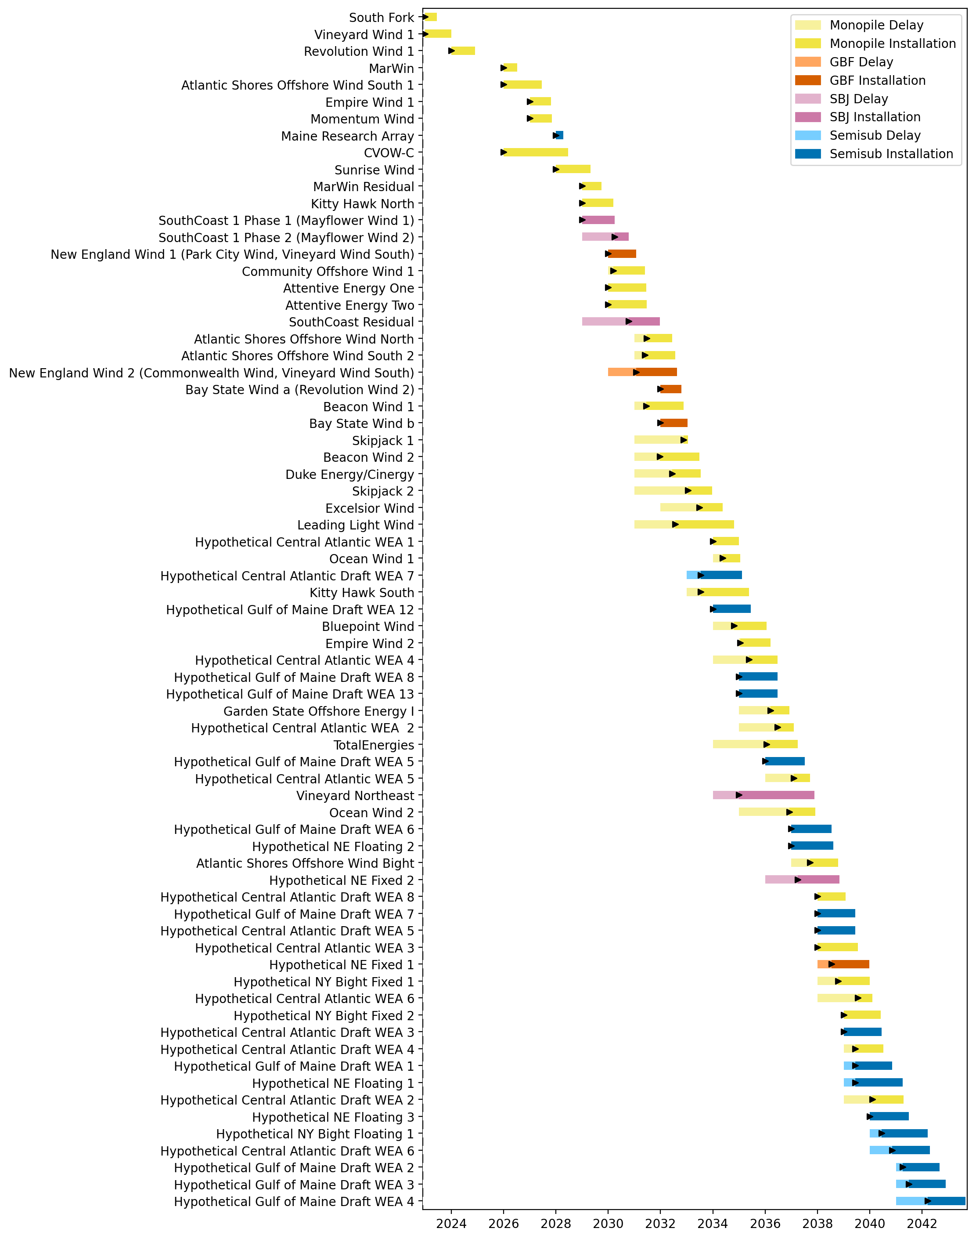
Full Gantt

Slide 20
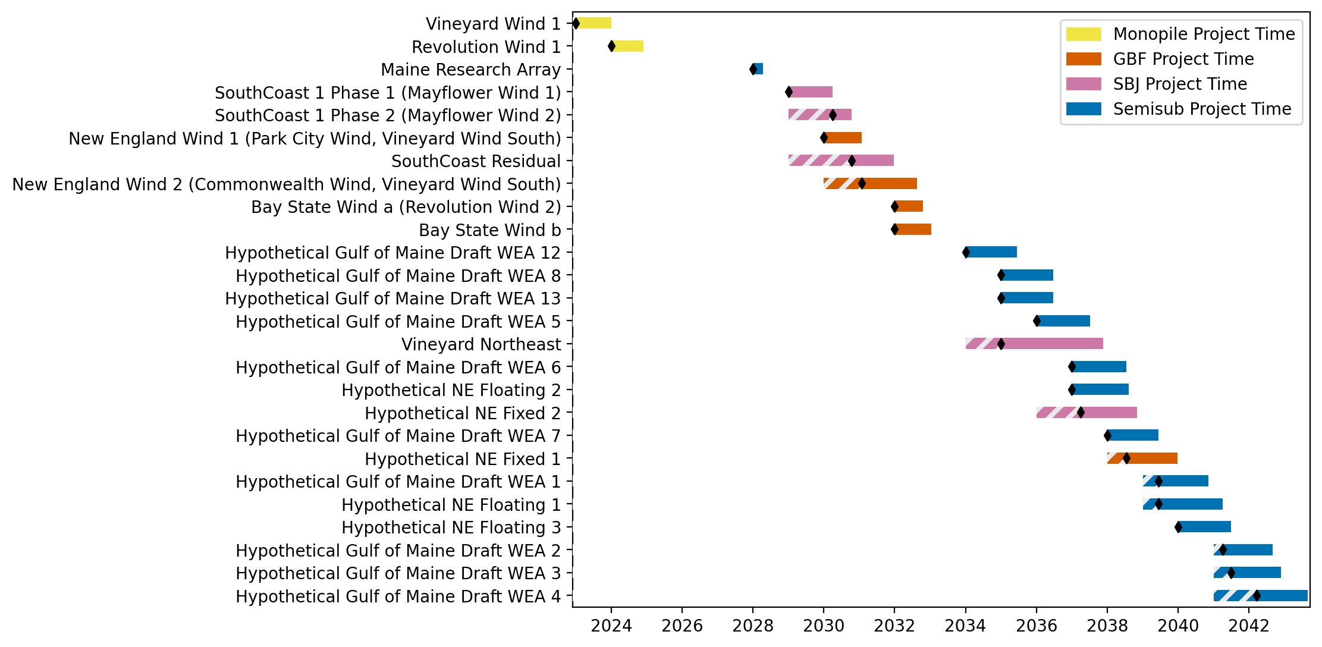
New England Gantt

Slide 21
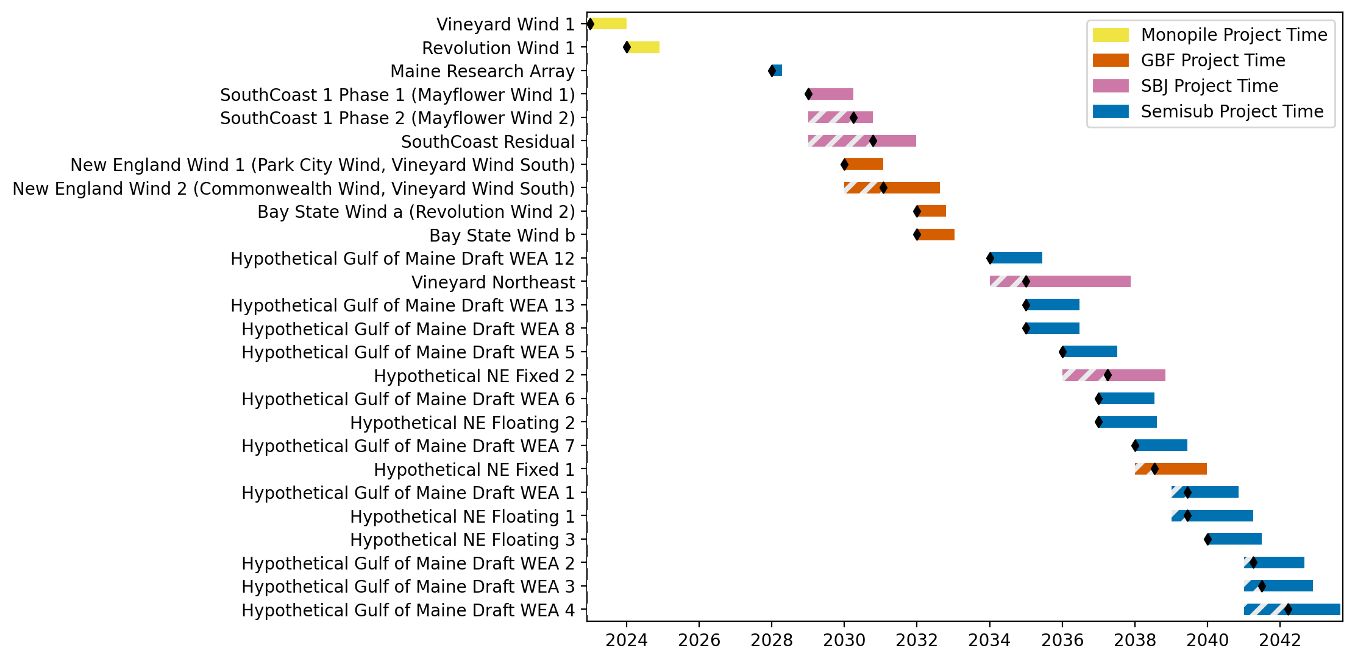
Sorted New England Gantt

Slide 22
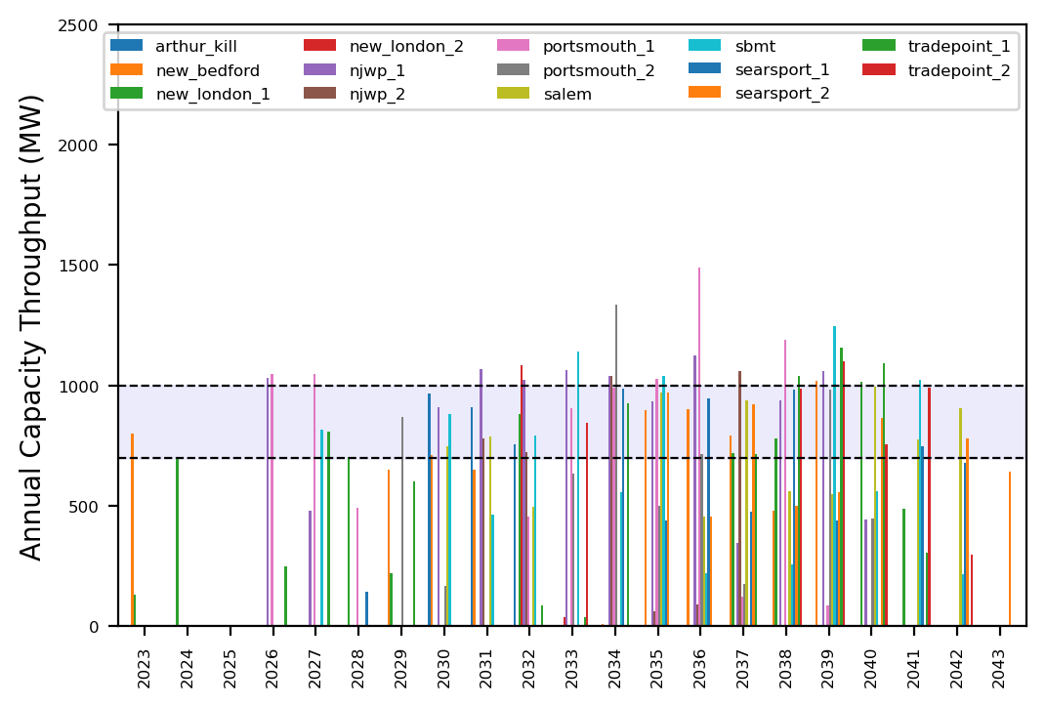
Port Throughput

Slide 23
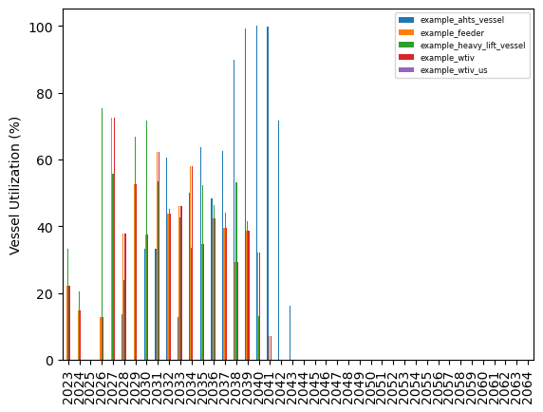
Vessel Utilization

Slide 24
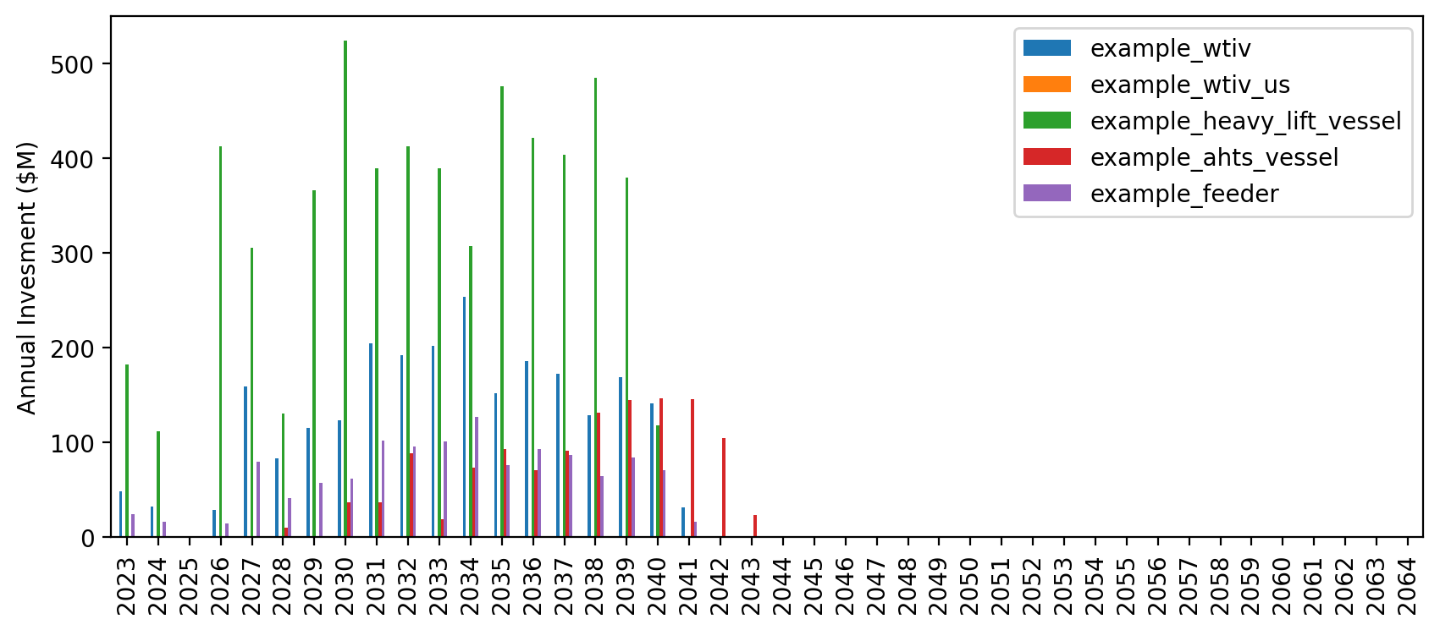
Vessel Revenue

Slide 25
Full Gantt

Slide 26
New England Gantt

Slide 27
Sorted New England Gantt

Slide 28
Port Throughput

Slide 29
Vessel Utilization

Slide 30
Vessel Revenue

Slide 31
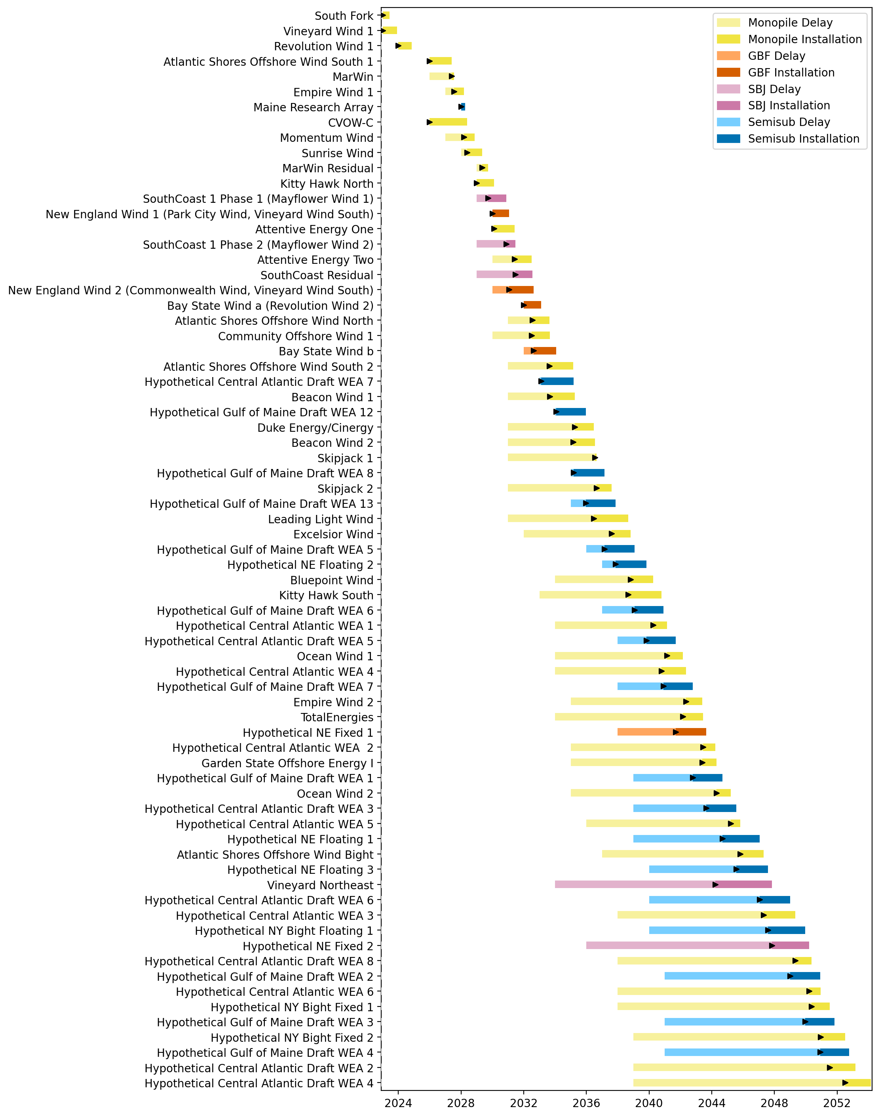
Full Gantt

Slide 32
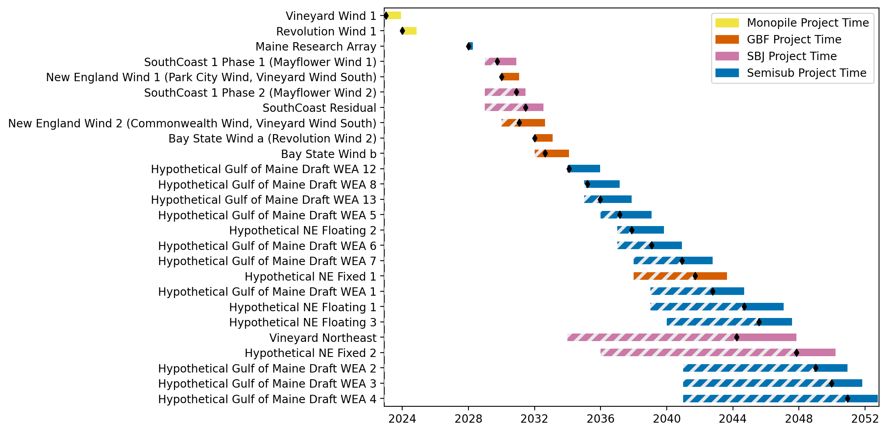
New England Gantt

Slide 33
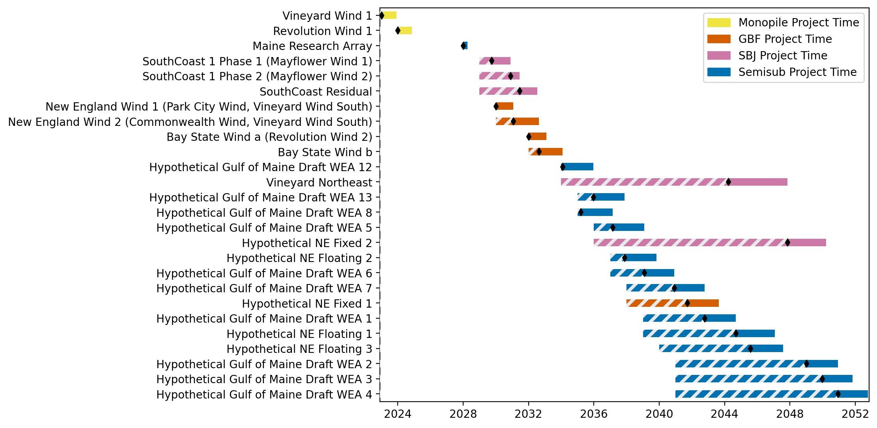
Sorted New England Gantt

Slide 34
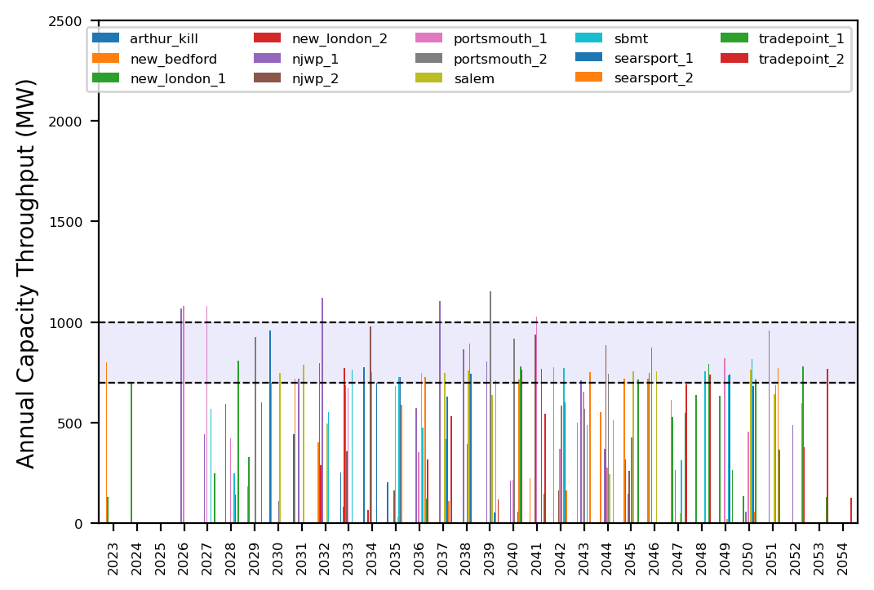
Port Throughput

Slide 35
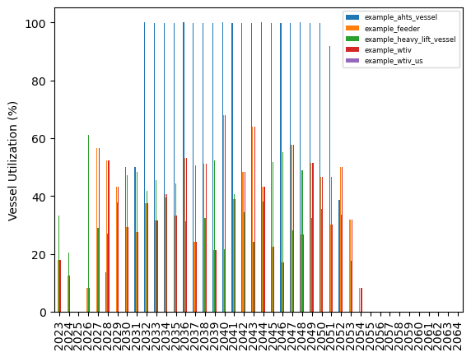
Vessel Utilization

Slide 36
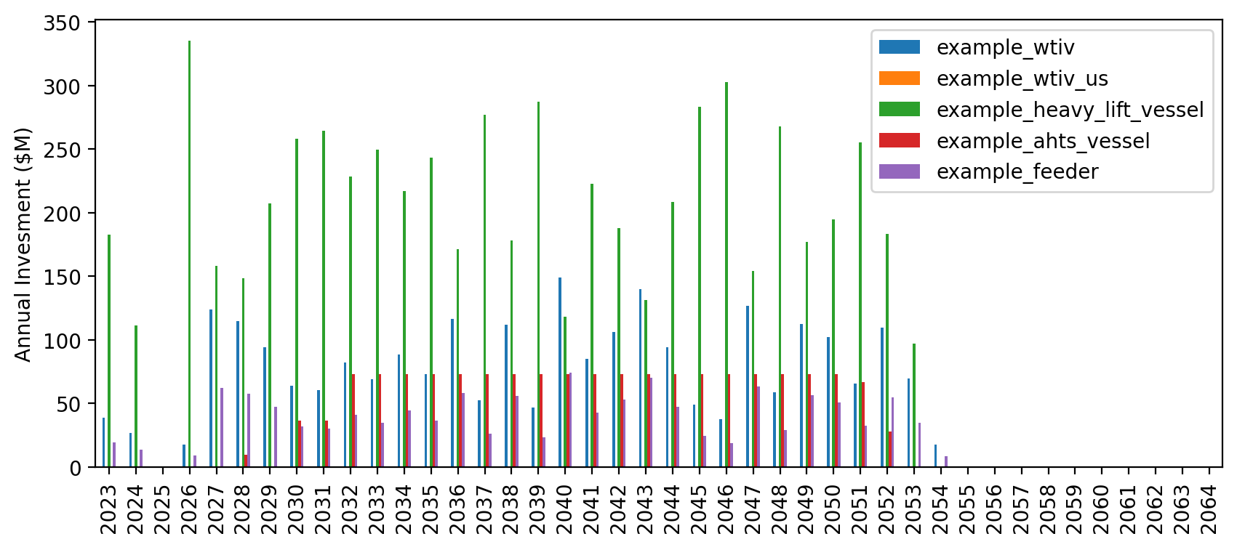
Vessel Revenue

Slide 37
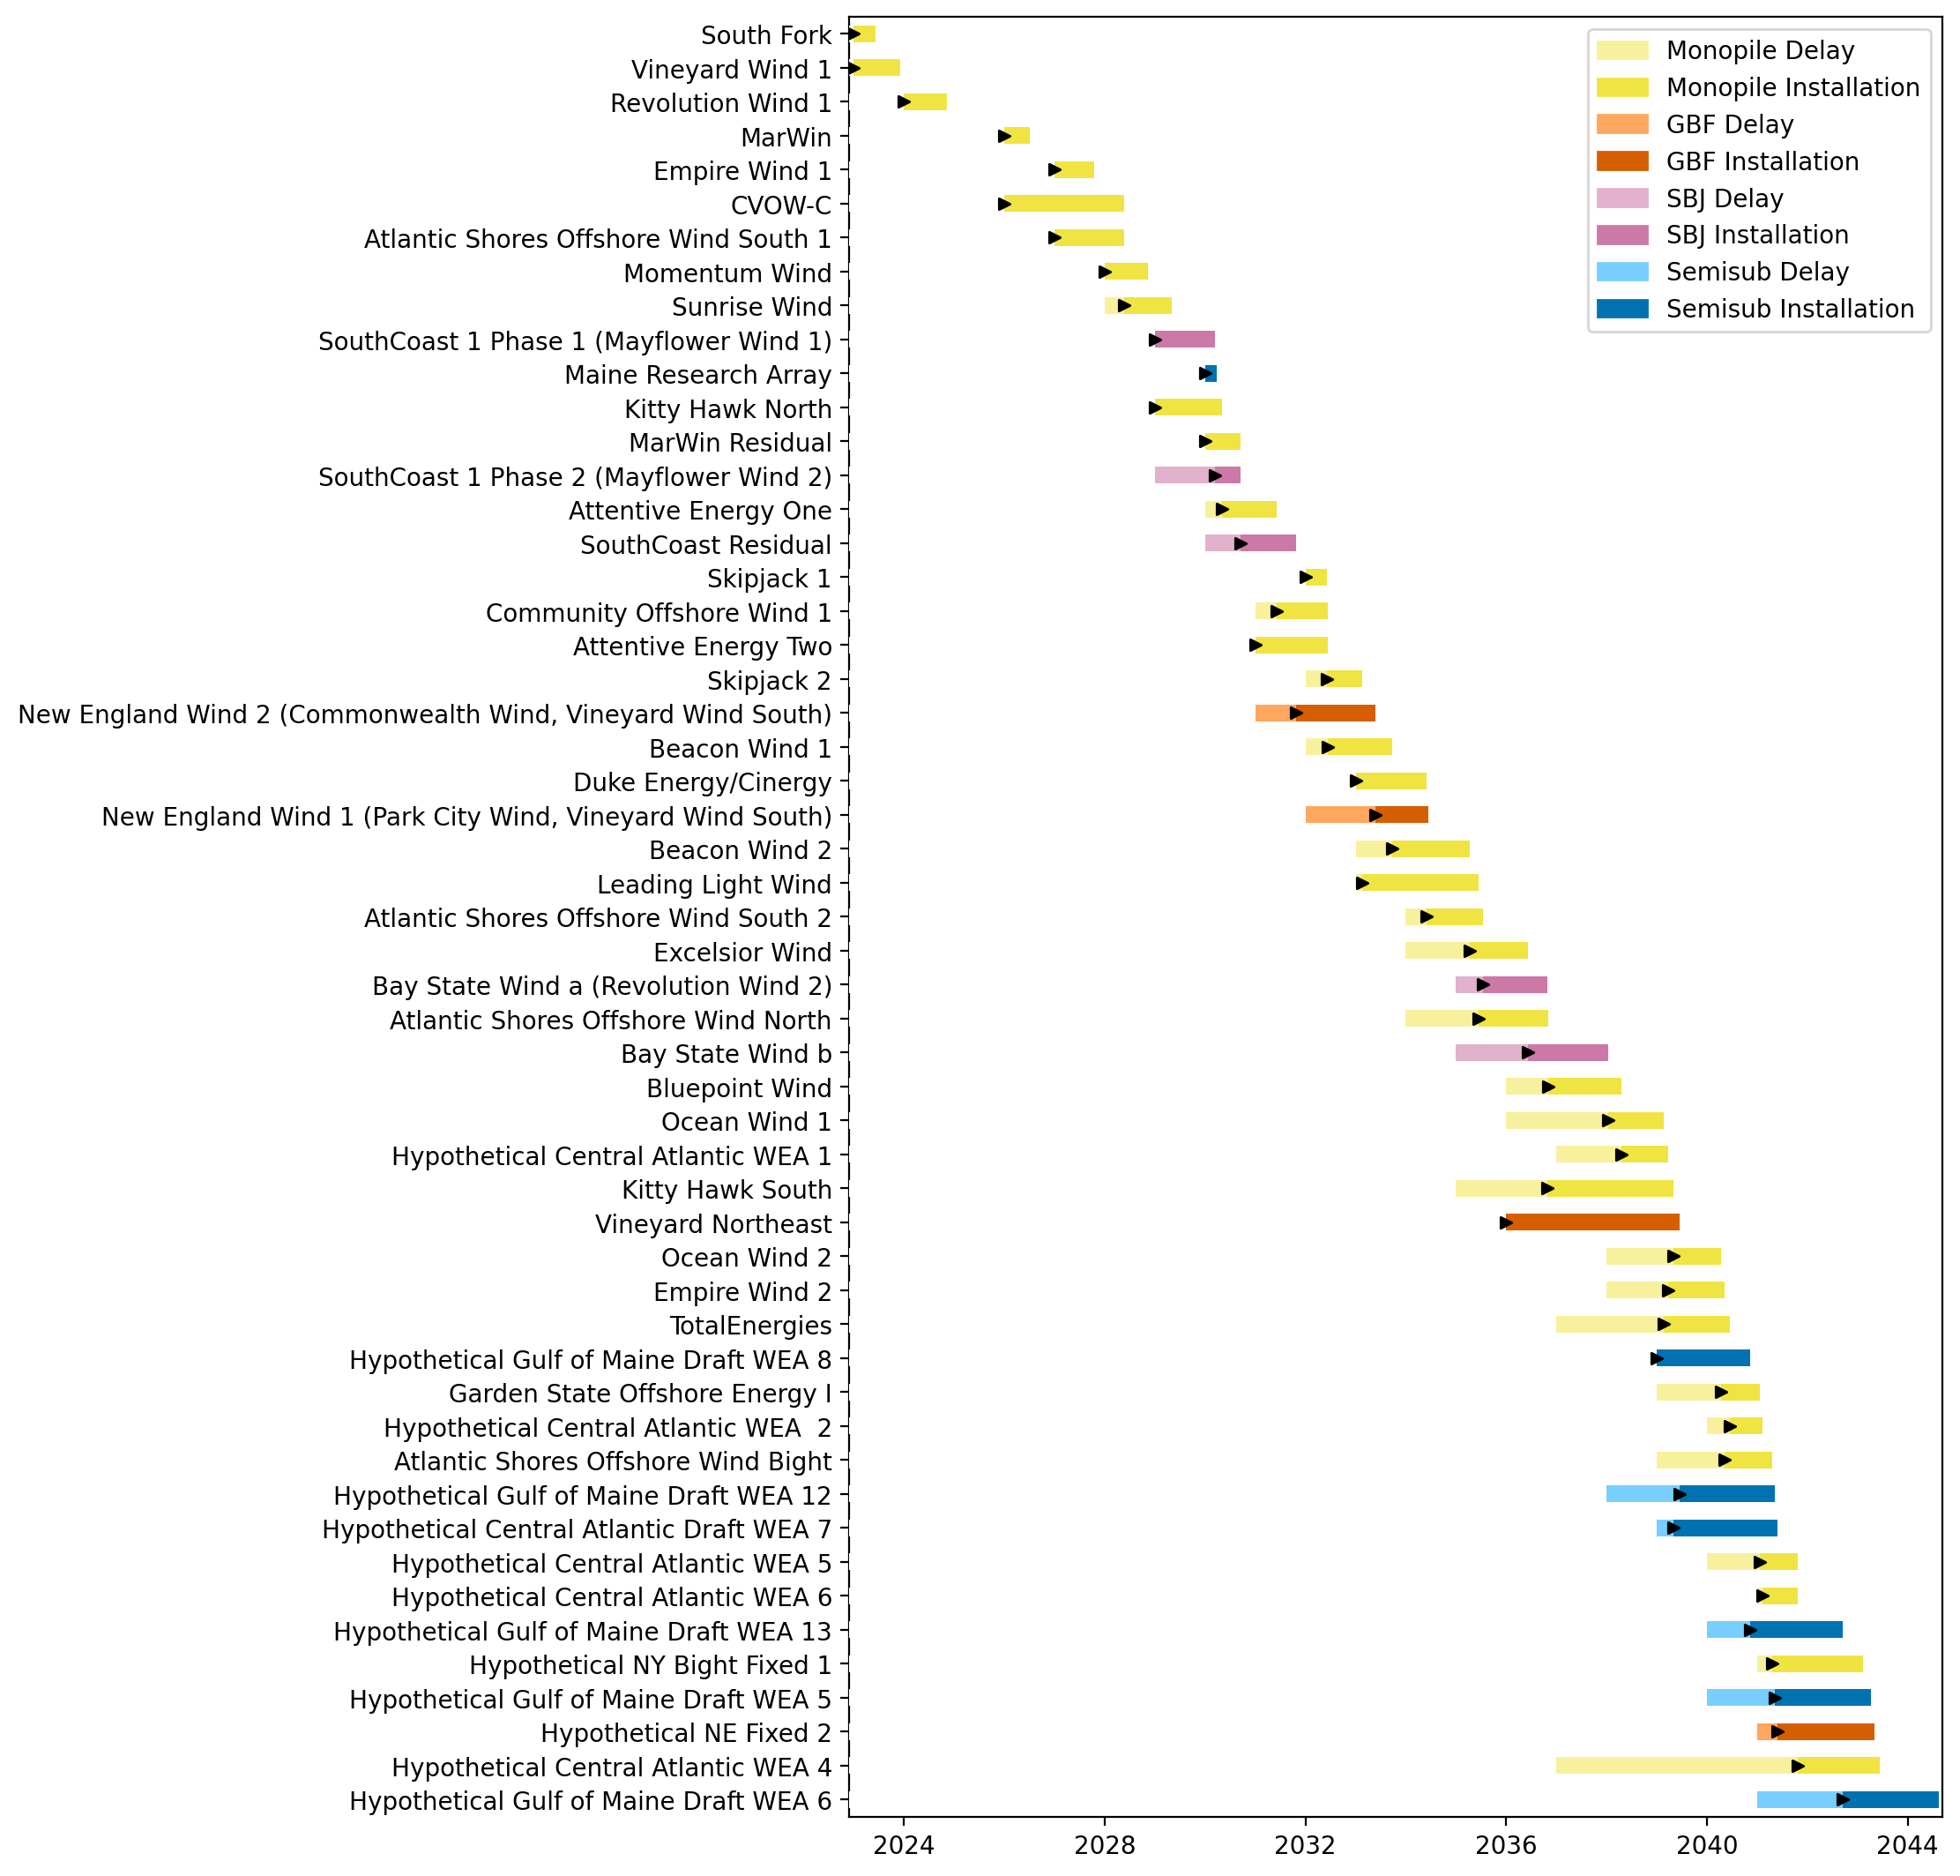
Full Gantt

Slide 38
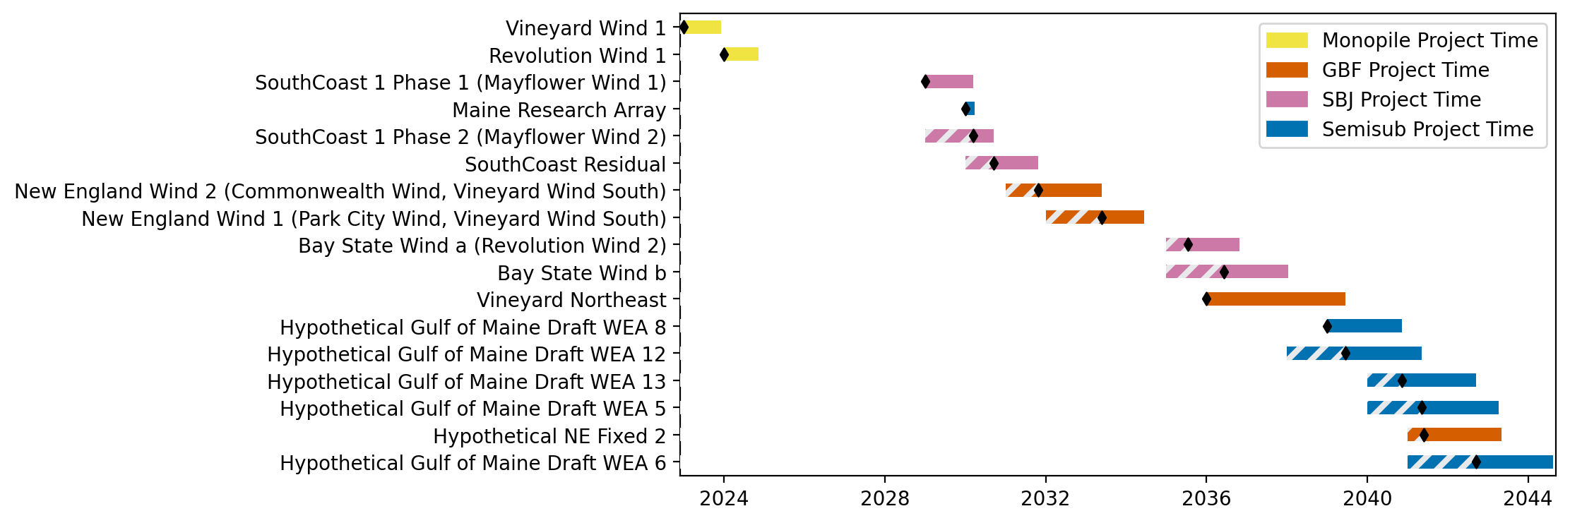
New England Gantt

Slide 39
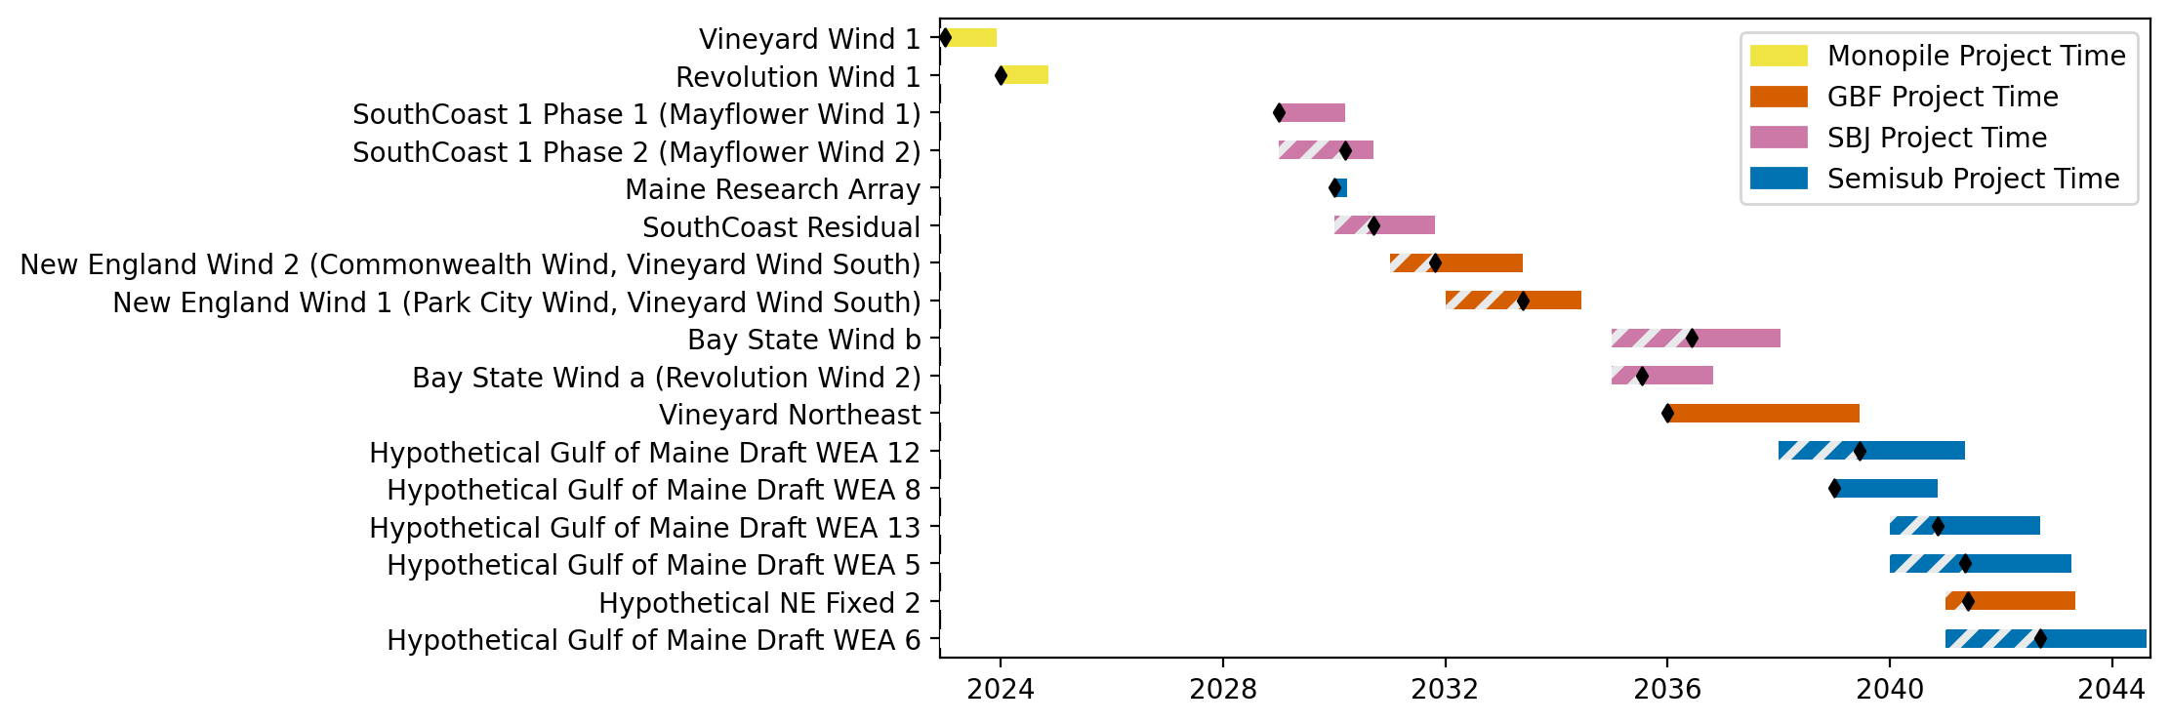
Sorted New England Gantt

Slide 40
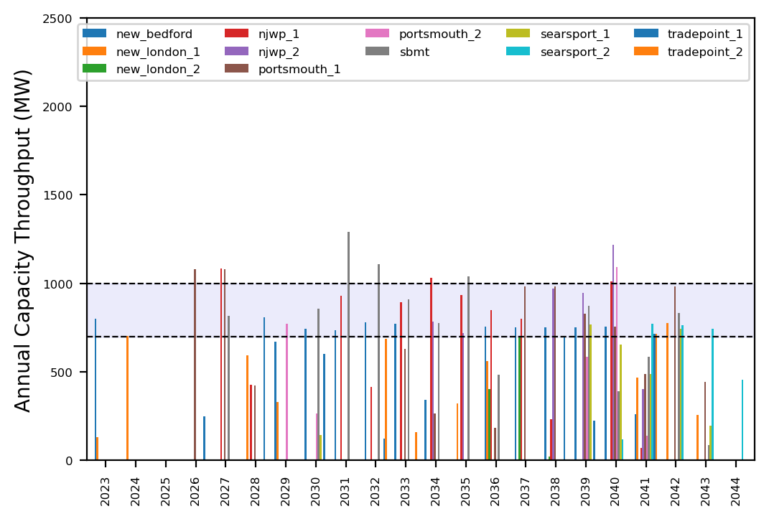
Port Throughput

Slide 41
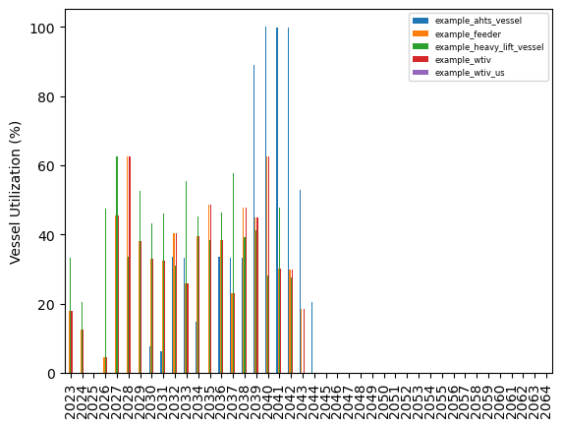
Vessel Utilization

Slide 42
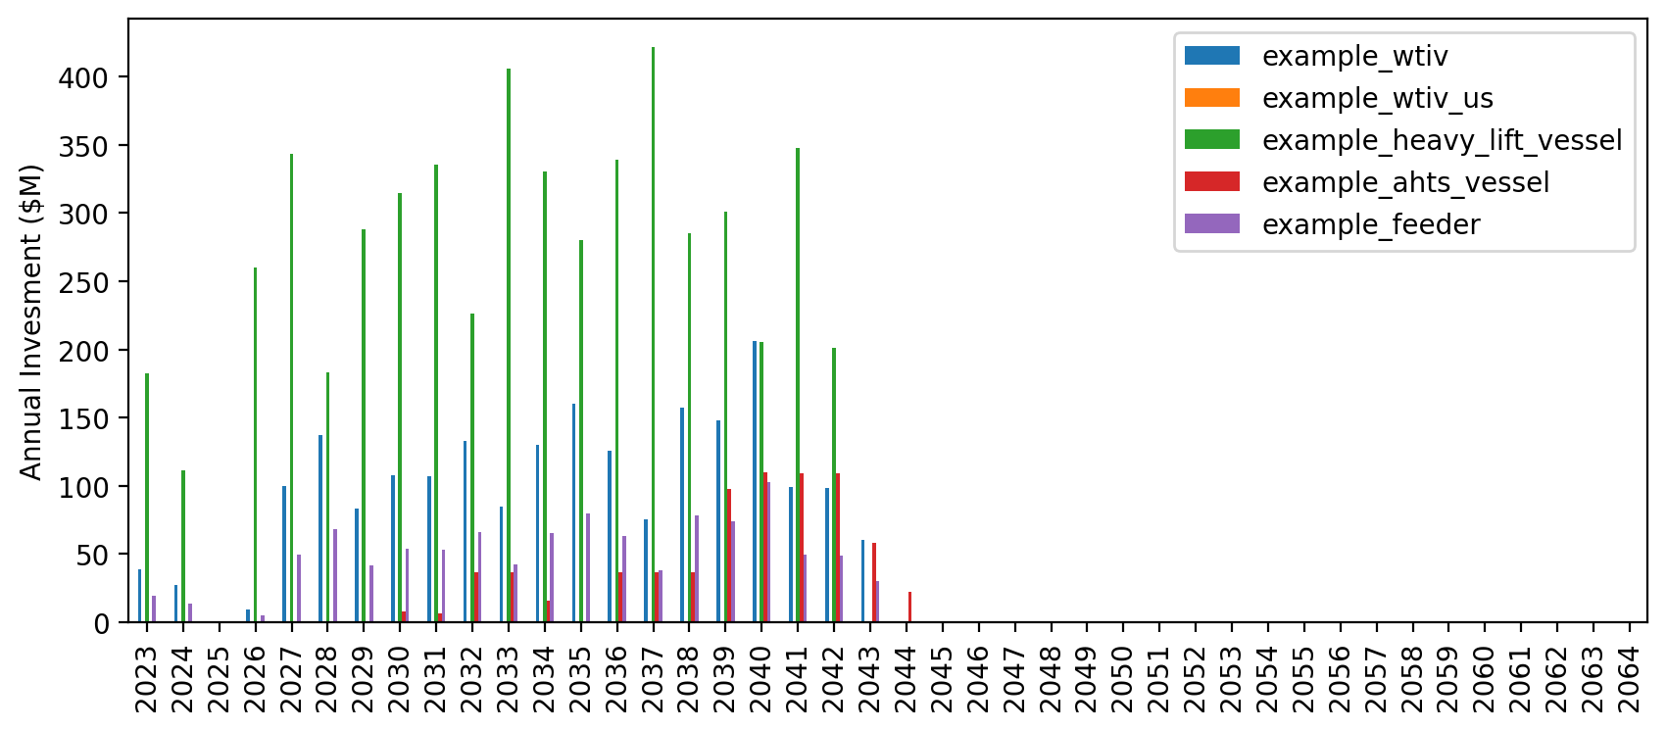
Vessel Revenue

Slide 43
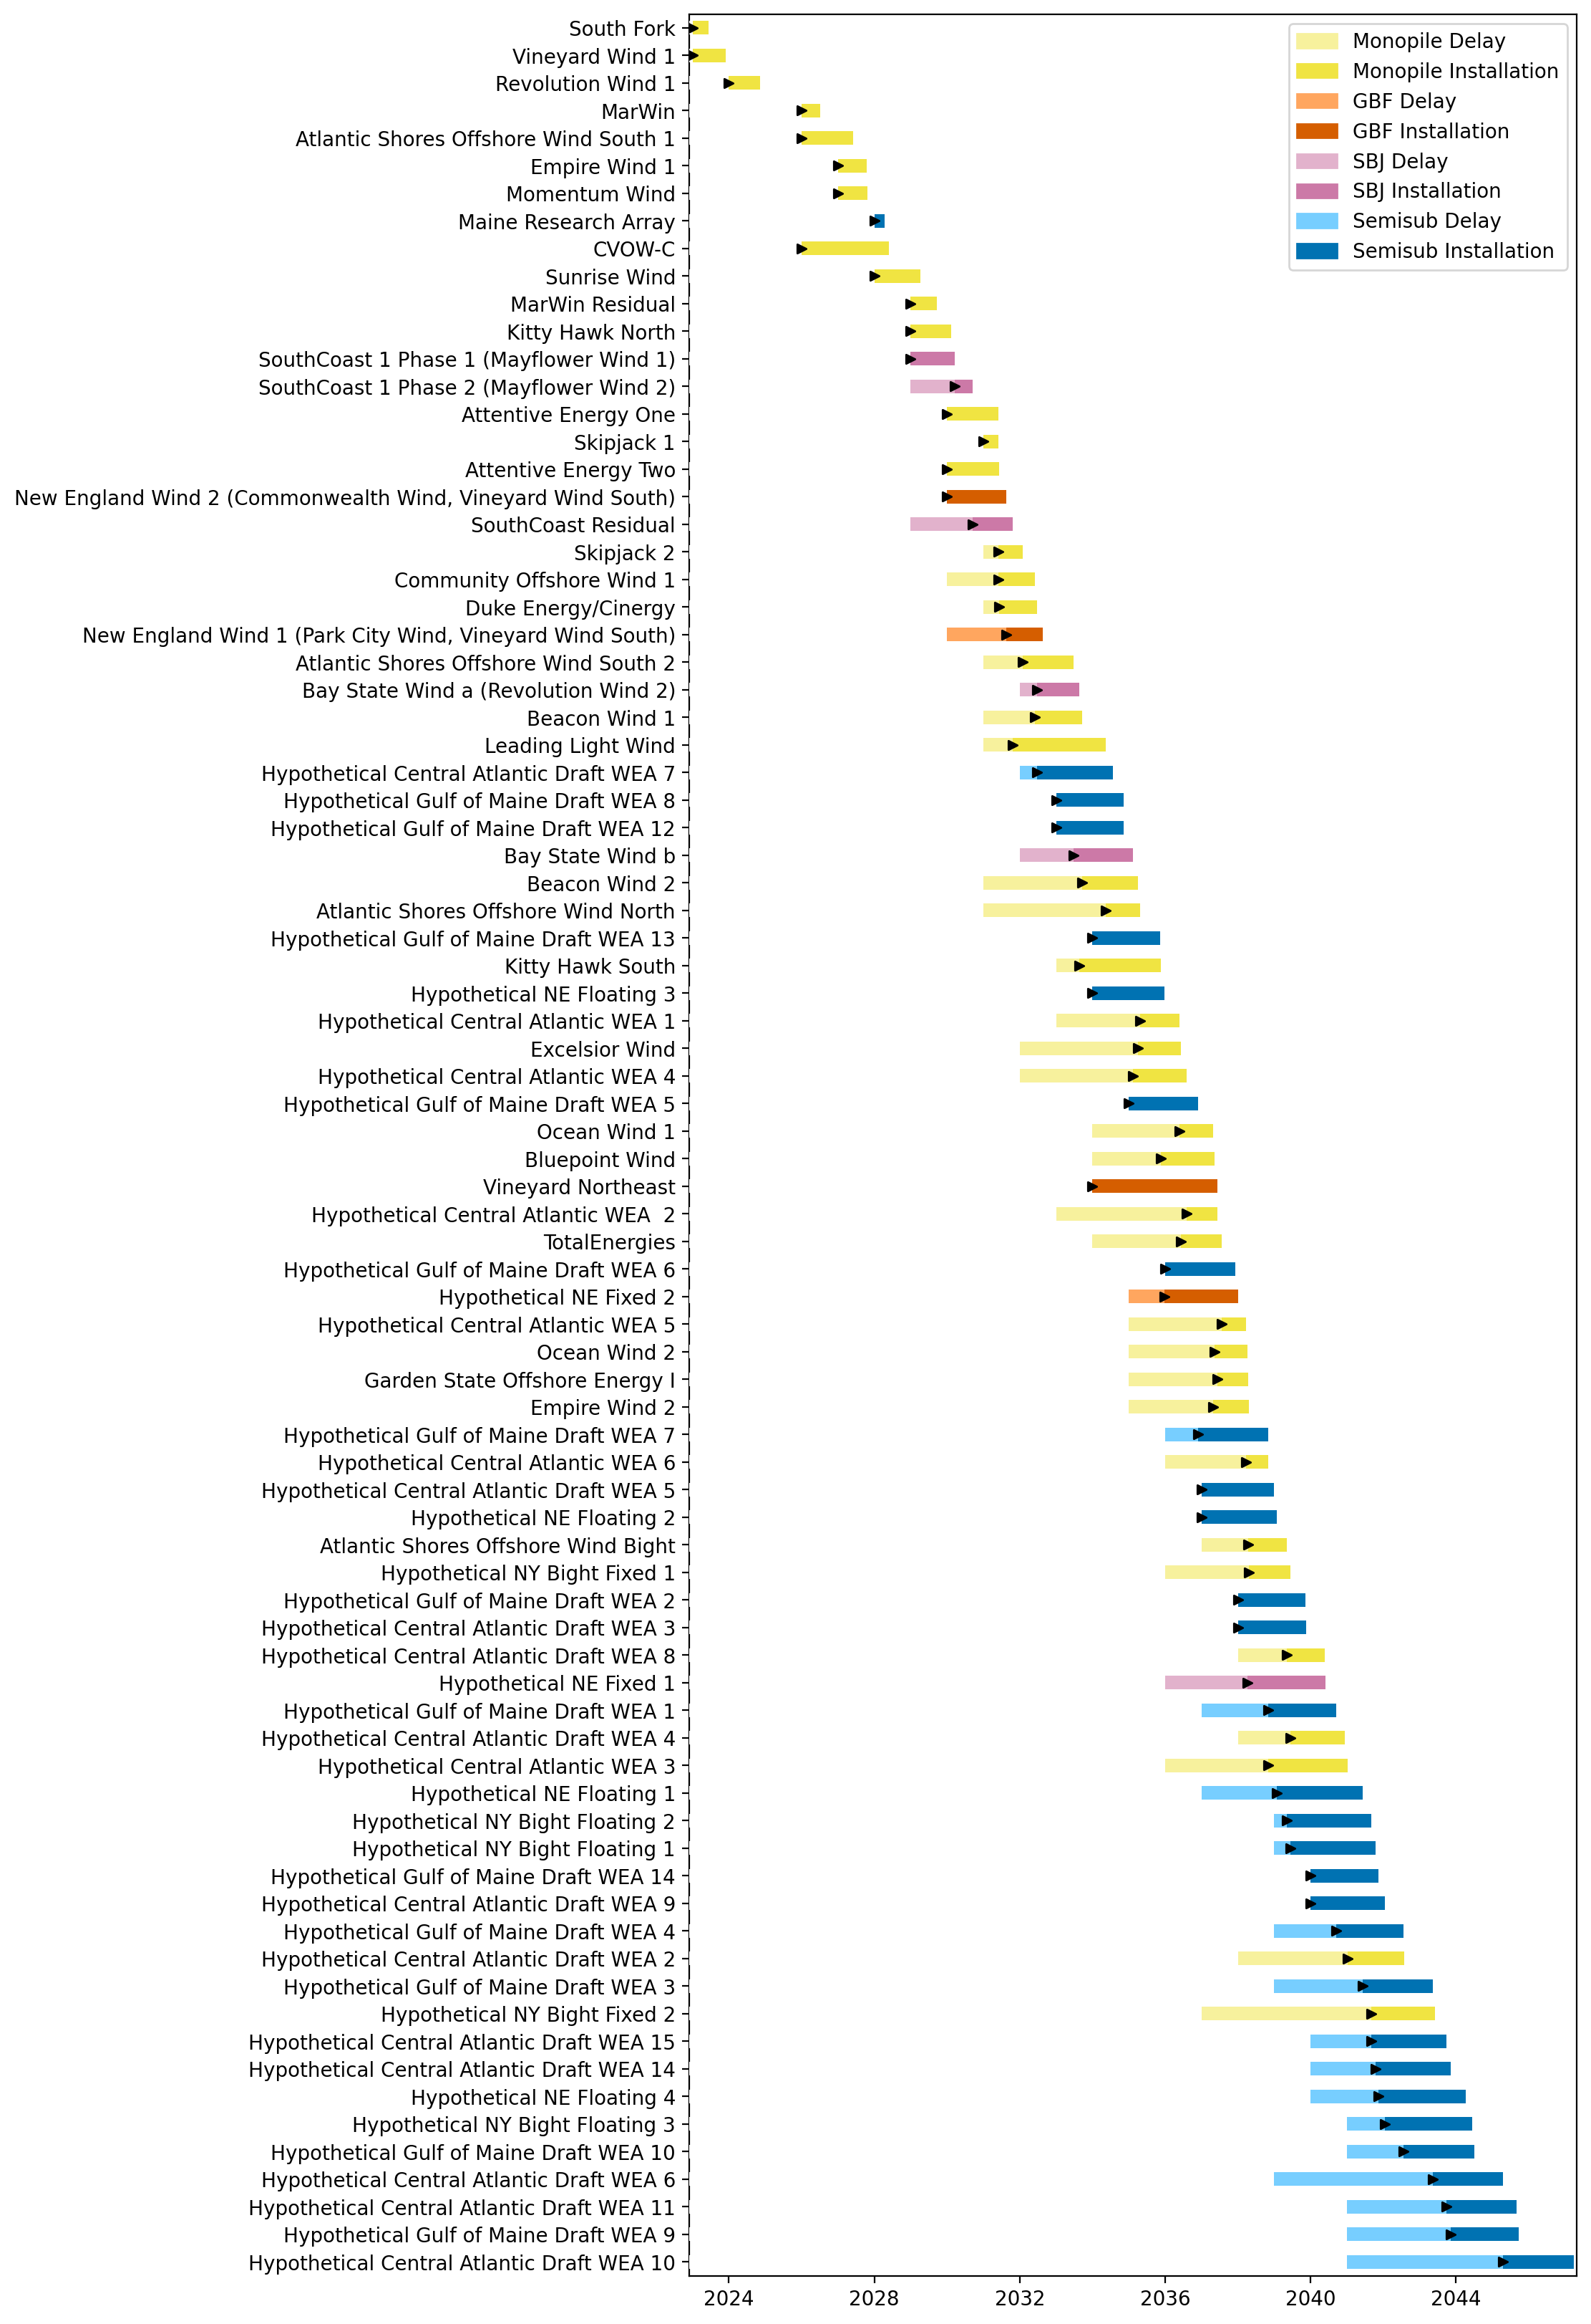
Full Gantt

Slide 44
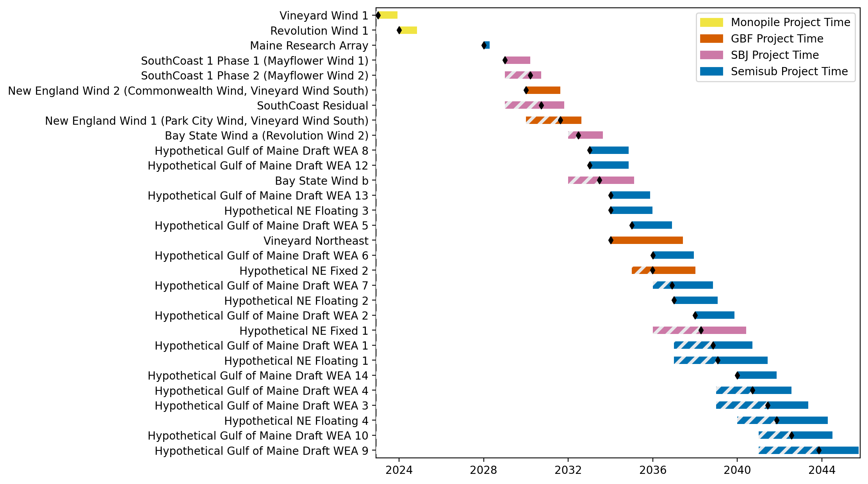
New England Gantt

Slide 45
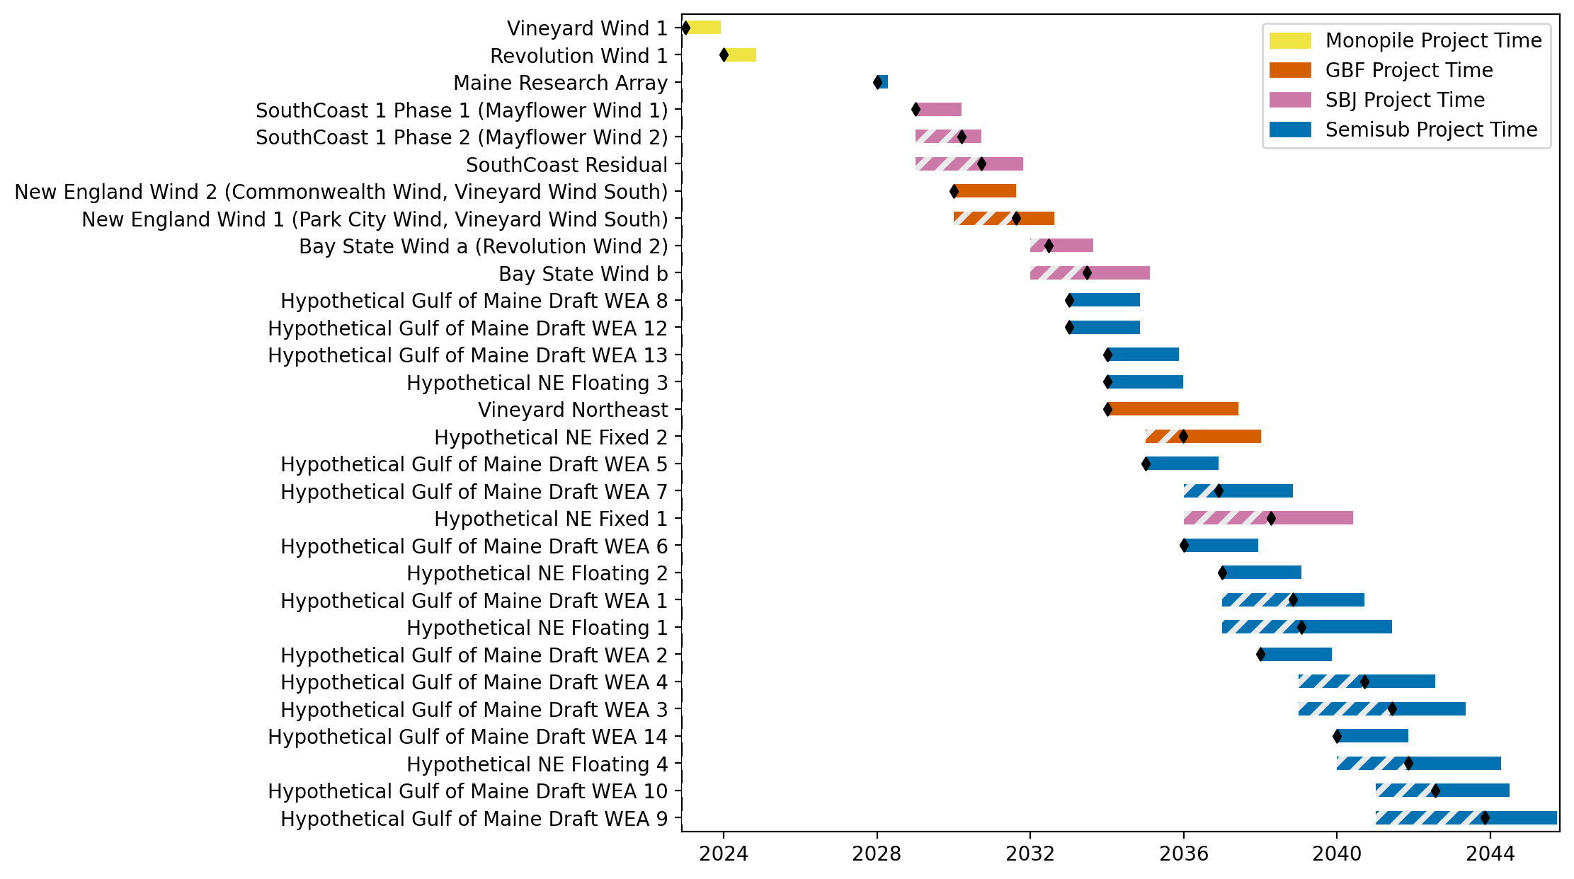
Sorted New England Gantt

Slide 46
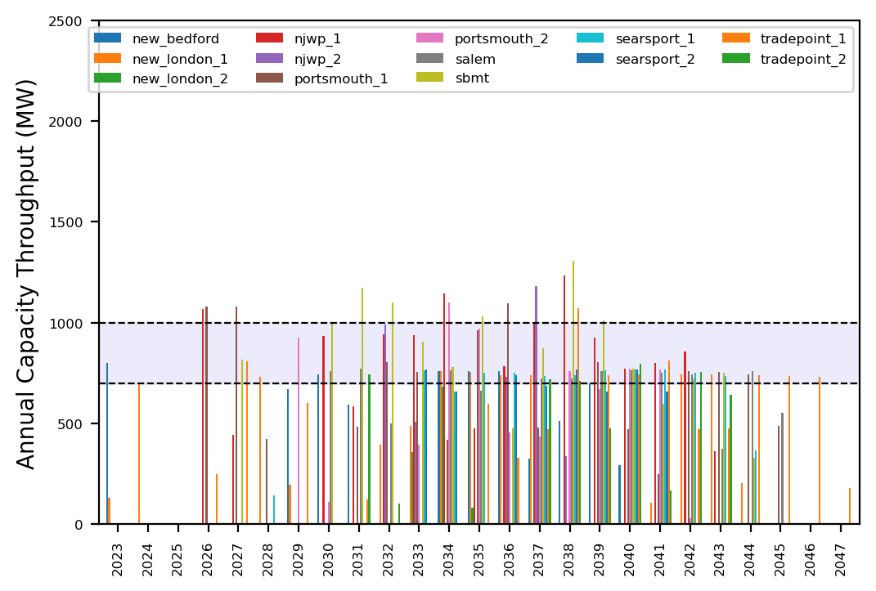
Port Throughput

Slide 47
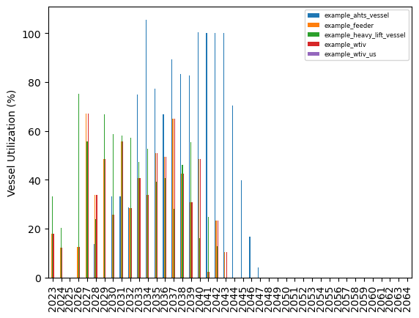
Vessel Utilization

Slide 48
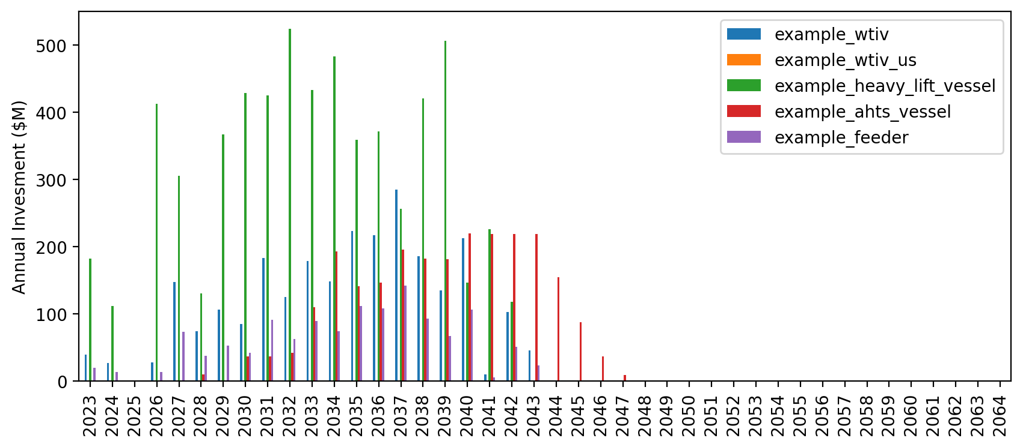
Vessel Revenue

Slide 49
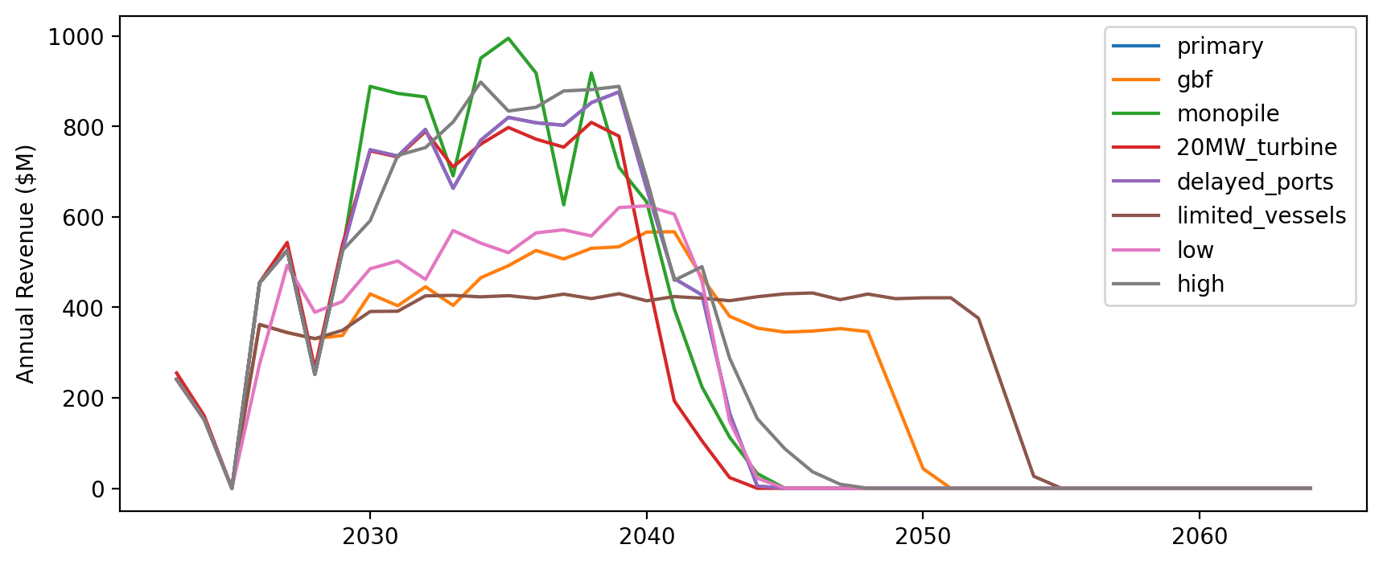
Vessel Revenue by Scenario

Slide 50
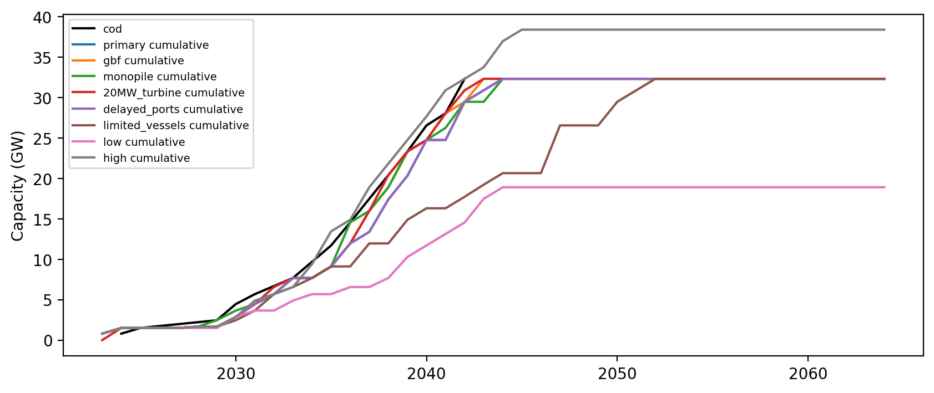
Installed Capacity

Slide 51
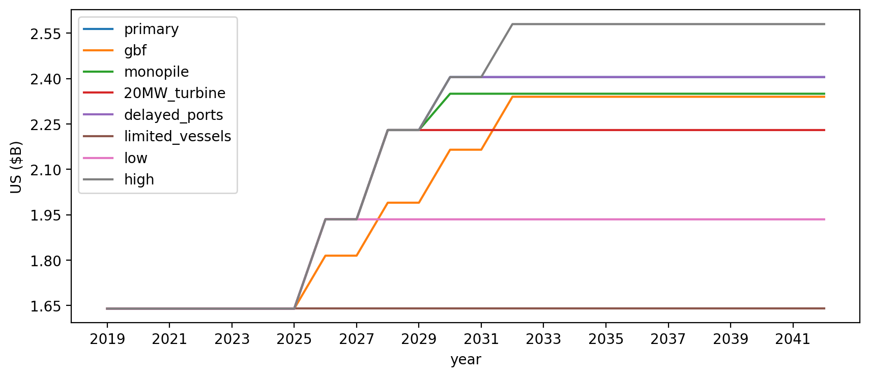
Vessel investment

Slide 52
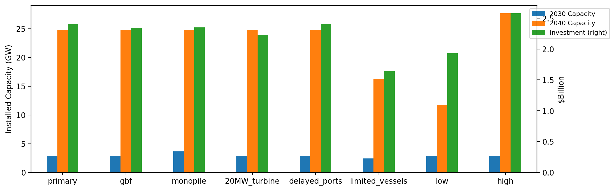
Summary Installed Cap/Investment

